Slide 1


Slide 2
Why “Learn”?
Machine learning is programming computers to optimize a performance criterion using example data or past experience.
There is no need to “learn” to calculate payroll
Learning is used when:
Human expertise does not exist (navigating on Mars),
Humans are unable to explain their expertise (speech recognition)
Solution changes in time (routing on a computer network)
Solution needs to be adapted to particular cases (user biometrics)

Slide 3
What We Talk About When We Talk About“Learning”
Learning general models from a data of particular examples
Data is cheap and abundant (data warehouses, data marts); knowledge is expensive and scarce.
Example in retail: Customer transactions to consumer behavior:
People who bought “Da Vinci Code” also bought “The Five People You Meet in Heaven” (www.amazon.com)
Build a model that is a good and useful approximation to the data.

Slide 4
What is Machine Learning?
Machine Learning
Study of algorithms that
improve their performance
at some task
with experience
Optimize a performance criterion using example data or past experience.
Role of Statistics: Inference from a sample
Role of Computer science: Efficient algorithms to
Solve the optimization problem
Representing and evaluating the model for inference

Slide 5
Growth of Machine Learning
Machine learning is preferred approach to
Speech recognition, Natural language processing
Computer vision
Medical outcomes analysis
Robot control
Computational biology
This trend is accelerating
Improved machine learning algorithms
Improved data capture, networking, faster computers
Software too complex to write by hand
New sensors / IO devices
Demand for self-customization to user, environment
It turns out to be difficult to extract knowledge from human experts→failure of expert systems in the 1980’s.

Slide 6
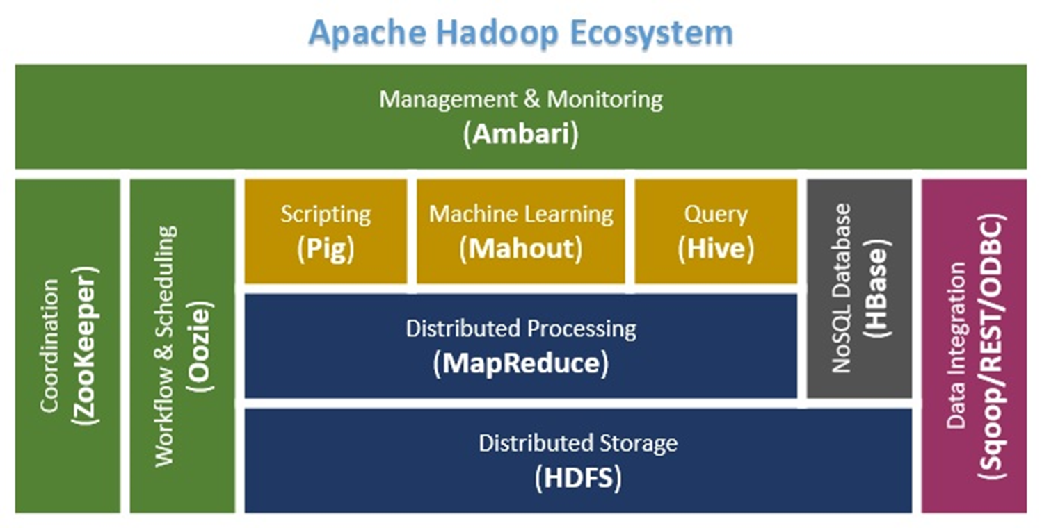
Machine Learning
https://www.dezyre.com/article/hadoop-components-and-architecture-big-data-and-hadoop-training/114

Slide 7
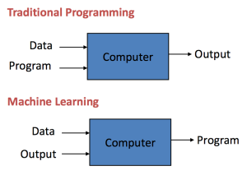
Machine Learning
http://machinelearningmastery.com/basic-concepts-in-machine-learning/

Slide 8

Machine Learning
https://blogs.nvidia.com/blog/2016/07/29/whats-difference-artificial-intelligence-machine-learning-deep-learning-ai/

Slide 9
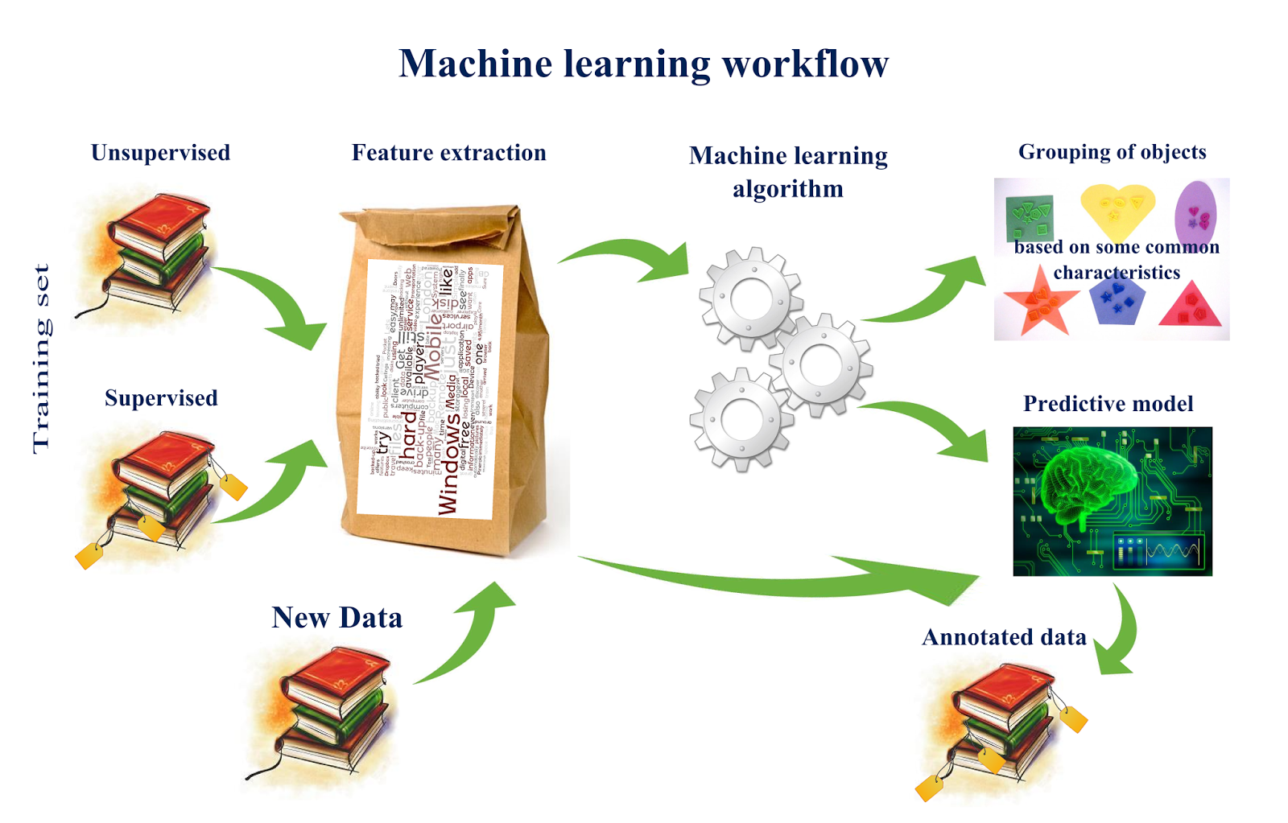
Machine Learning
http://www.computervisionblog.com/2015/03/deep-learning-vs-machine-learning-vs.html

Slide 10
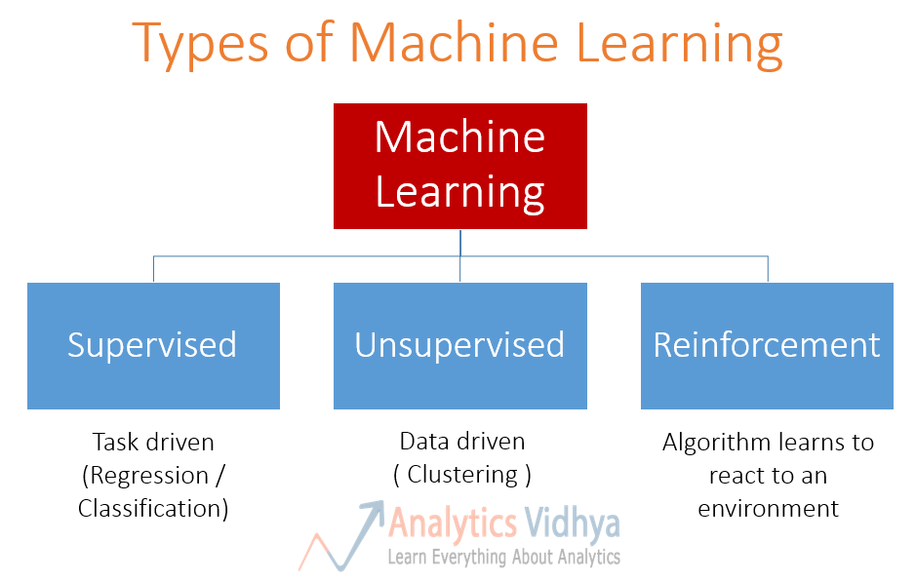
Machine Learning
https://www.analyticsvidhya.com/blog/2015/06/machine-learning-basics/

Slide 11
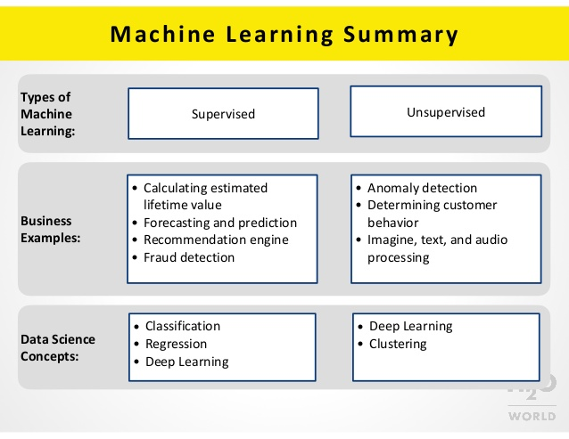
Machine Learning
https://www.slideshare.net/0xdata/h2o-world-machine-learning-for-nondata-scientists

Slide 12
Supervised Learning: Uses
Example: decision trees tools that create rules
Prediction of future cases: Use the rule to predict the output for future inputs
Knowledge extraction: The rule is easy to understand
Compression: The rule is simpler than the data it explains
Outlier detection: Exceptions that are not covered by the rule, e.g., fraud

Slide 13
Unsupervised Learning
Learning “what normally happens”
No output
Clustering: Grouping similar instances
Other applications: Summarization, Association Analysis
Example applications
Customer segmentation in CRM
Image compression: Color quantization
Bioinformatics: Learning motifs

Slide 14
Reinforcement Learning
Topics:
Policies: what actions should an agent take in a particular situation
Utility estimation: how good is a state (→used by policy)
No supervised output but delayed reward
Credit assignment problem (what was responsible for the outcome)
Applications:
Game playing
Robot in a maze
Multiple agents, partial observability, ...

Slide 15
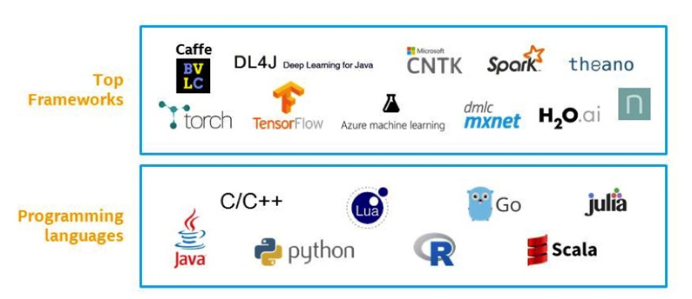
Frameworks for Machine Learning
Machine Learning
https://www.linkedin.com/pulse/machine-learning-becomes-mainstream-how-increase-your-ronald-van-loon

Slide 16
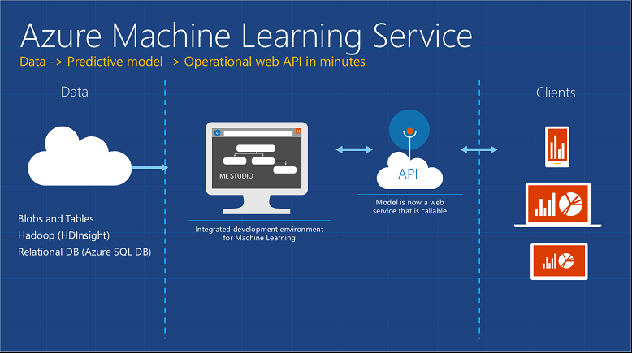
Machine Learning

Slide 17
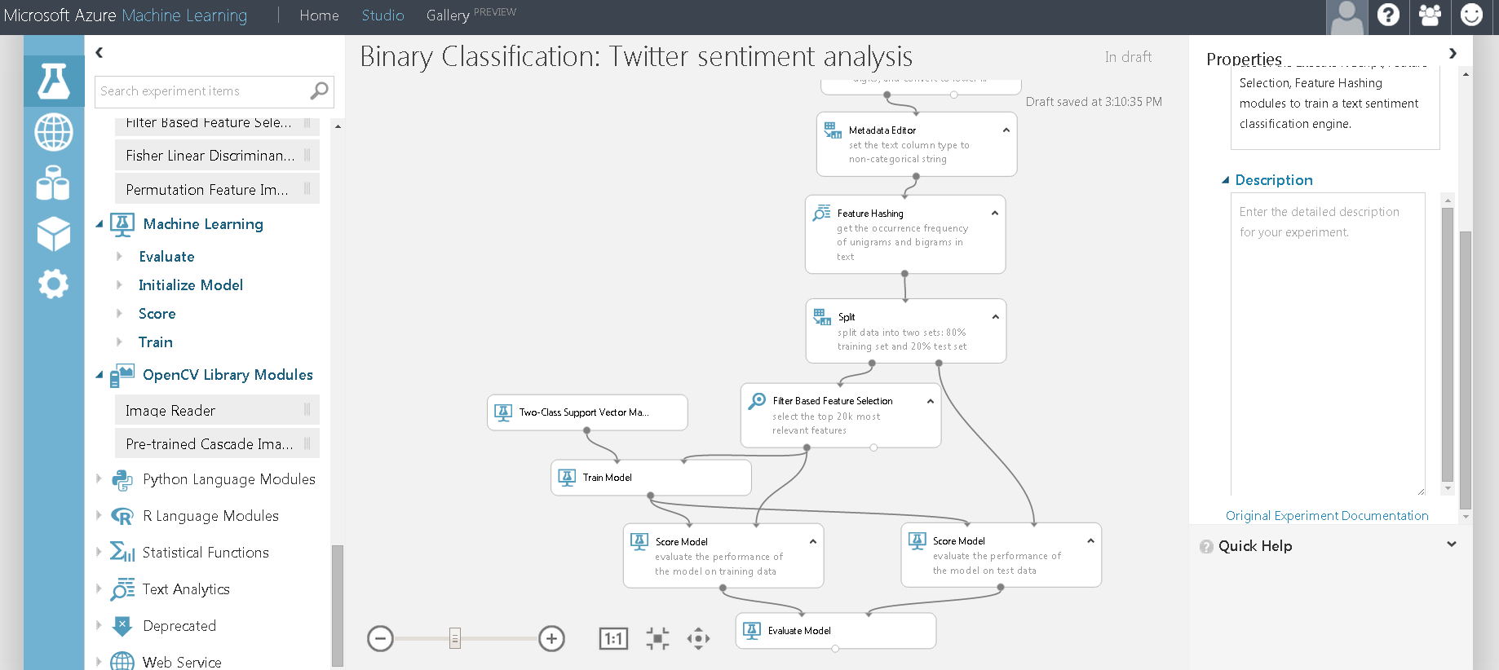
Machine Learning
https://robusttechhouse.com/microsoft-azure-machine-learning-review/

Slide 18
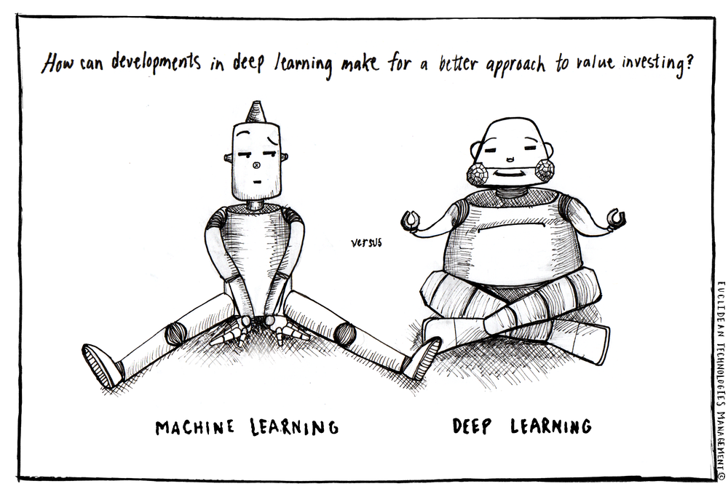
Machine Learning
http://www.euclidean.com/deep-learning-and-value-investing/

Slide 19
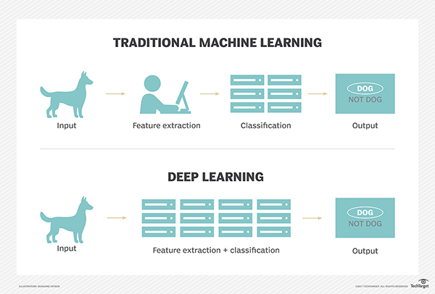
Machine Learning
http://searchbusinessanalytics.techtarget.com/definition/deep-learning

Slide 20

Machine Learning

Slide 21

http://www.bigdatatraining.in/data-visualization-training-chennai/

Slide 22
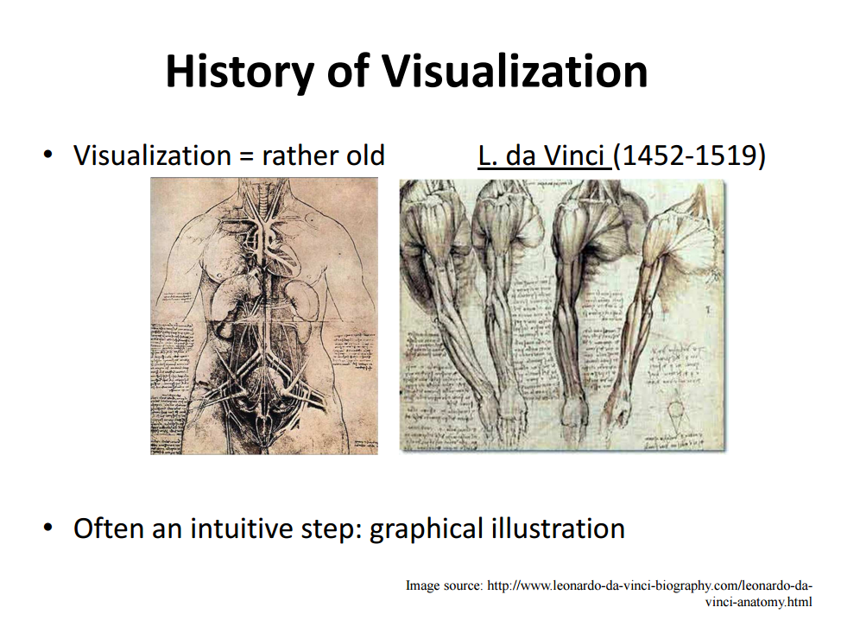
Data Visualization

Slide 23
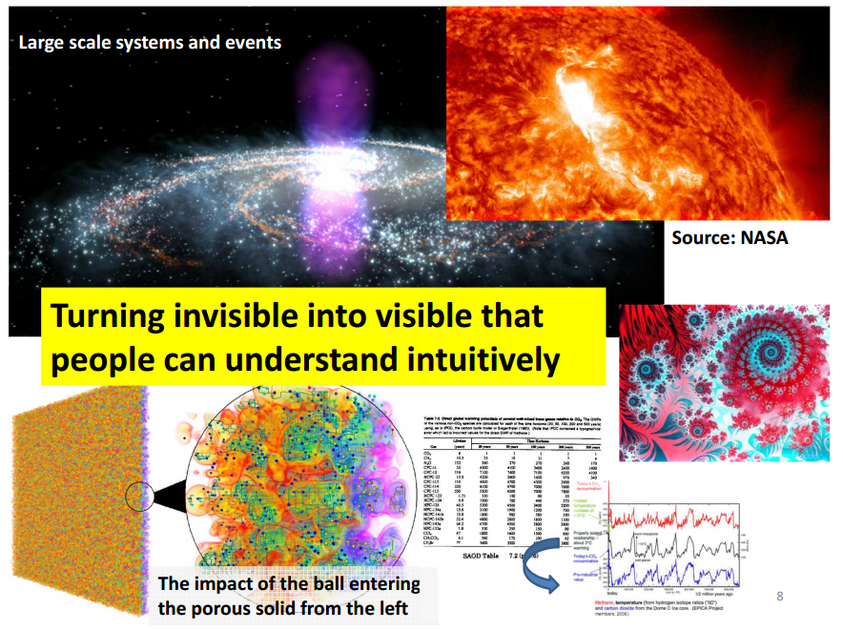
Data Visualization
http://www2.cs.uh.edu/~gnawali/courses/cosc6397-f13

Slide 24
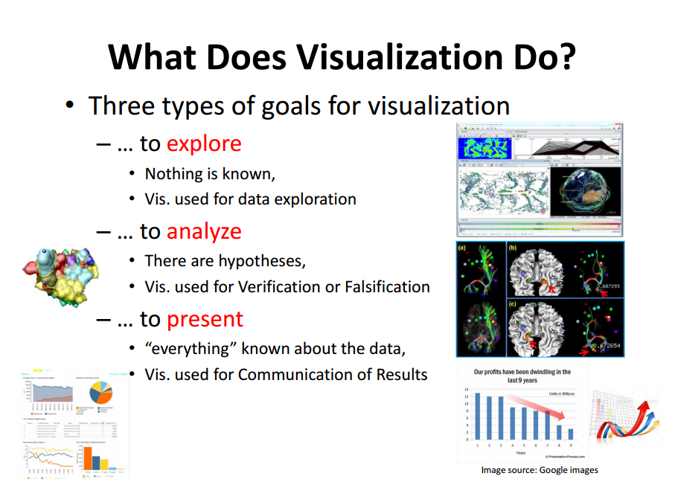
Data Visualization
http://www2.cs.uh.edu/~gnawali/courses/cosc6397-f13

Slide 25
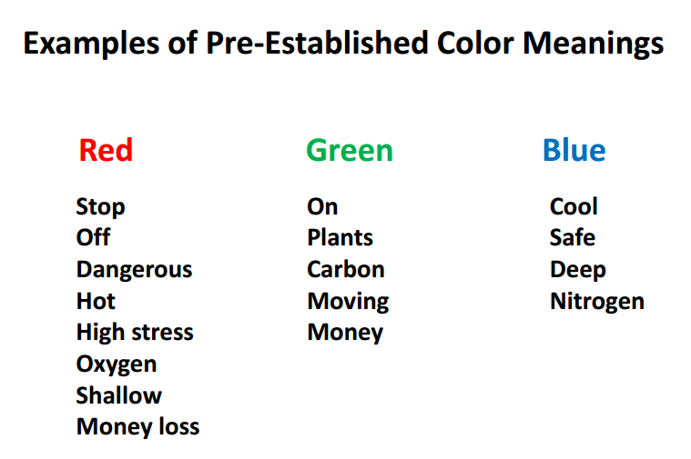
Data Visualization
http://www2.cs.uh.edu/~gnawali/courses/cosc6397-f13

Slide 26
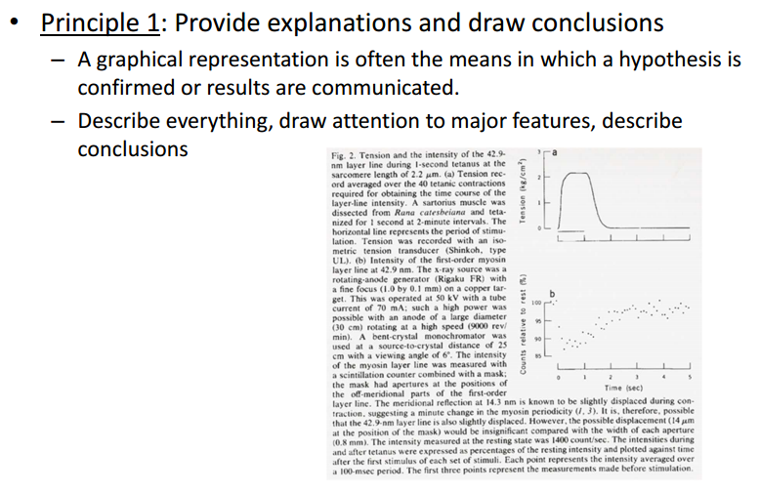
Data Visualization
Improving the Understanding
http://www2.cs.uh.edu/~gnawali/courses/cosc6397-f13

Slide 27
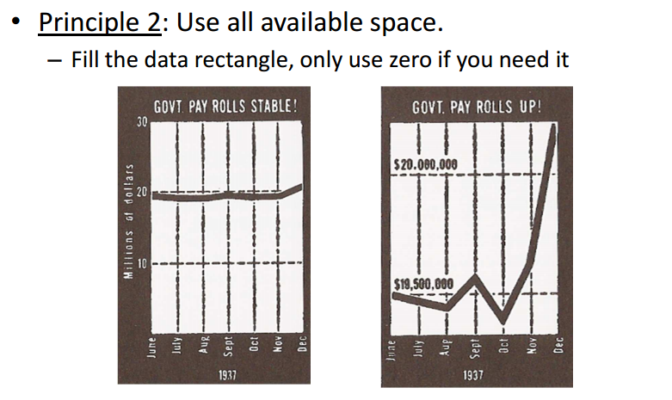
Data Visualization
Improving the Understanding
http://www2.cs.uh.edu/~gnawali/courses/cosc6397-f13

Slide 28
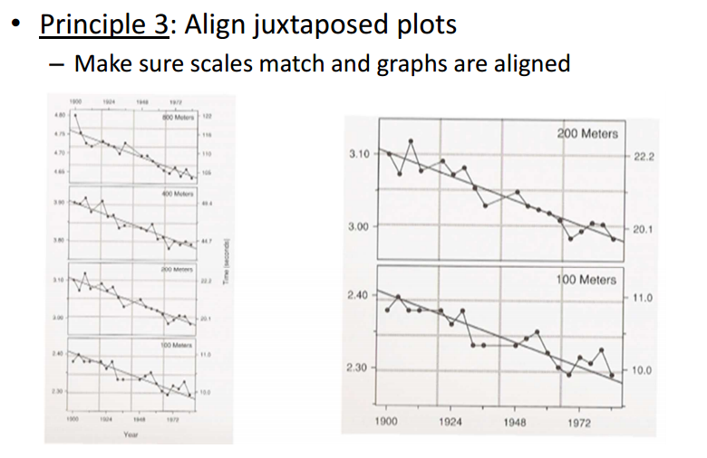
Data Visualization
Improving the Understanding
http://www2.cs.uh.edu/~gnawali/courses/cosc6397-f13

Slide 29
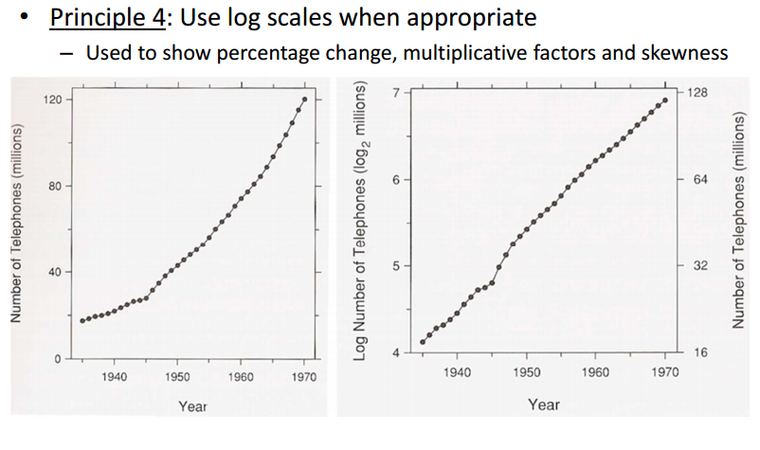
Data Visualization
Improving the Understanding
http://www2.cs.uh.edu/~gnawali/courses/cosc6397-f13

Slide 30
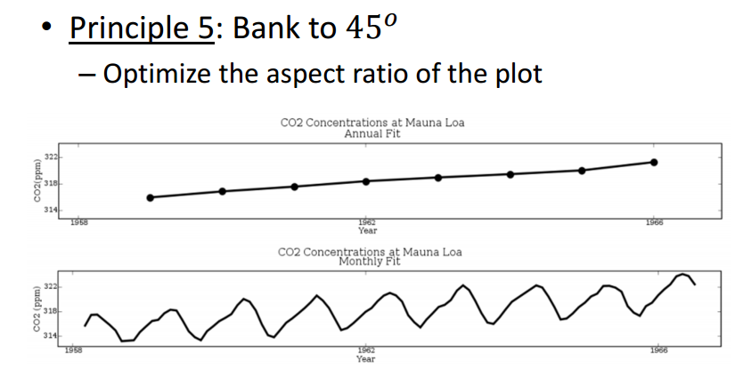
Data Visualization
Improving the Understanding
http://www2.cs.uh.edu/~gnawali/courses/cosc6397-f13

Slide 31
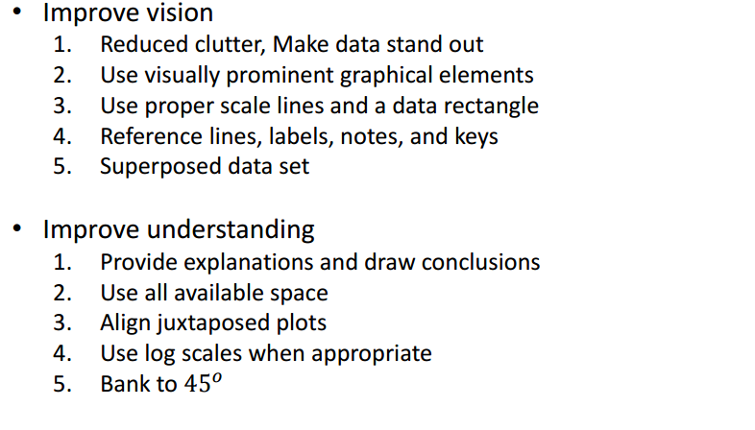
Data Visualization
Summary of Principles
http://www2.cs.uh.edu/~gnawali/courses/cosc6397-f13

Slide 32
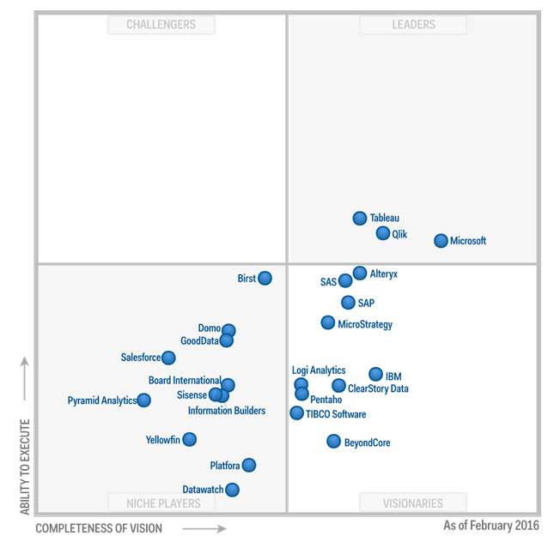
Data Visualization
http://optimalbi.com/blog/2017/02/17/gartner-magic-quadrant-for-business-intelligence-2017-cloud-is-coming-slowly/

Slide 33
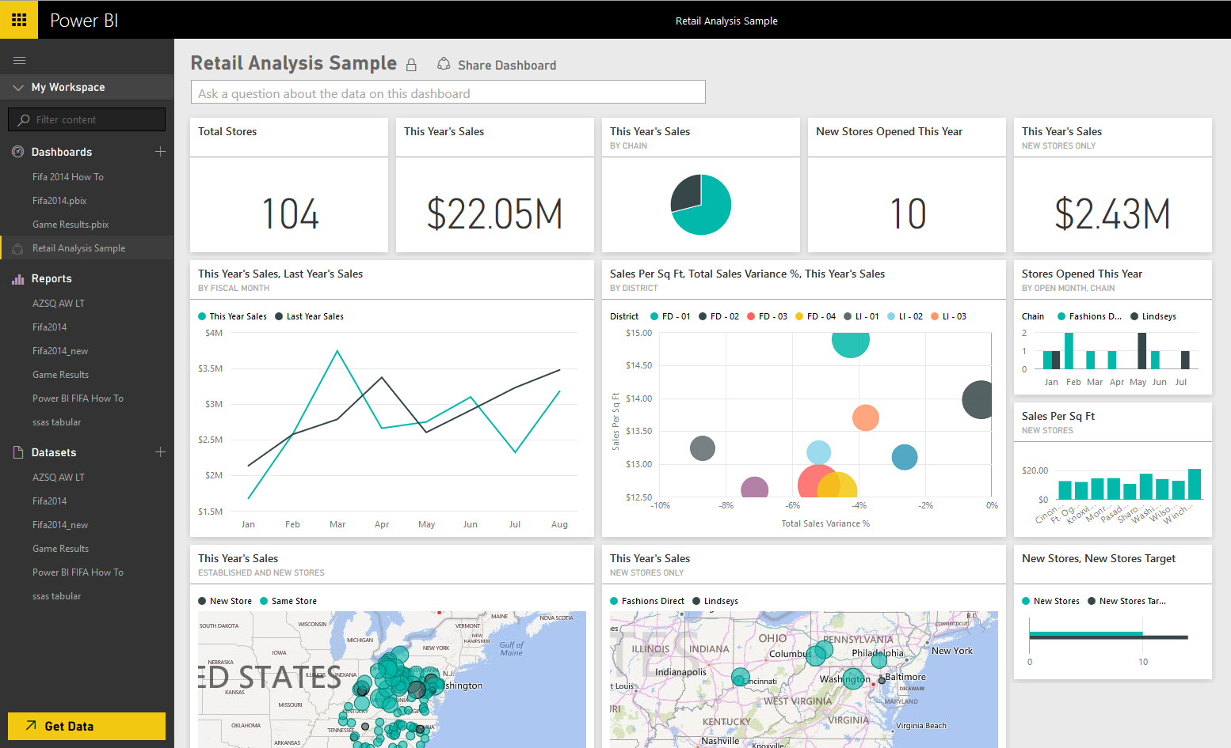

Data Visualization

Slide 34
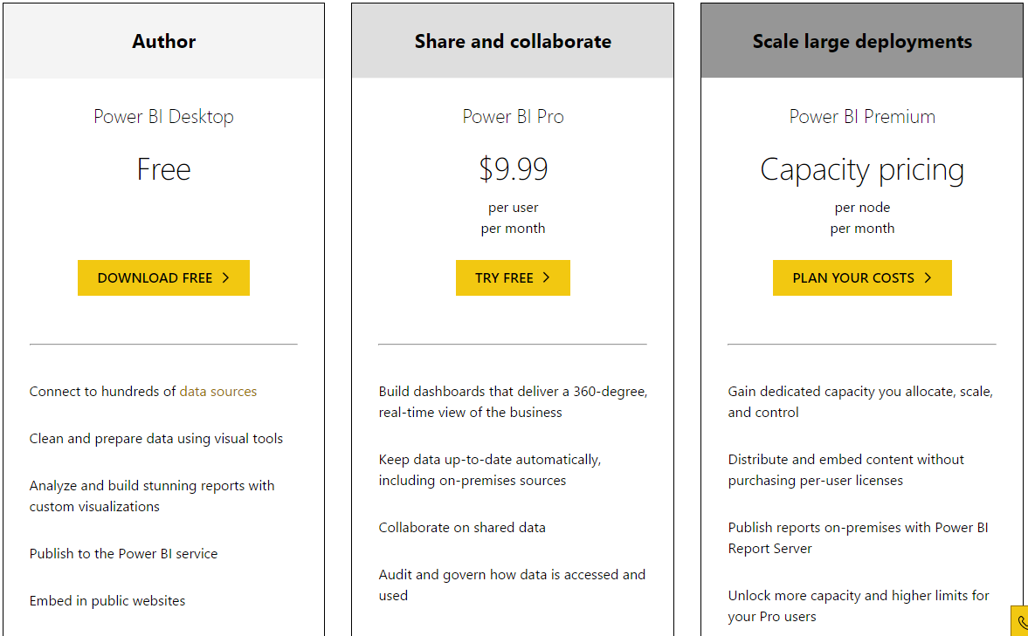
Data Visualization

Slide 35
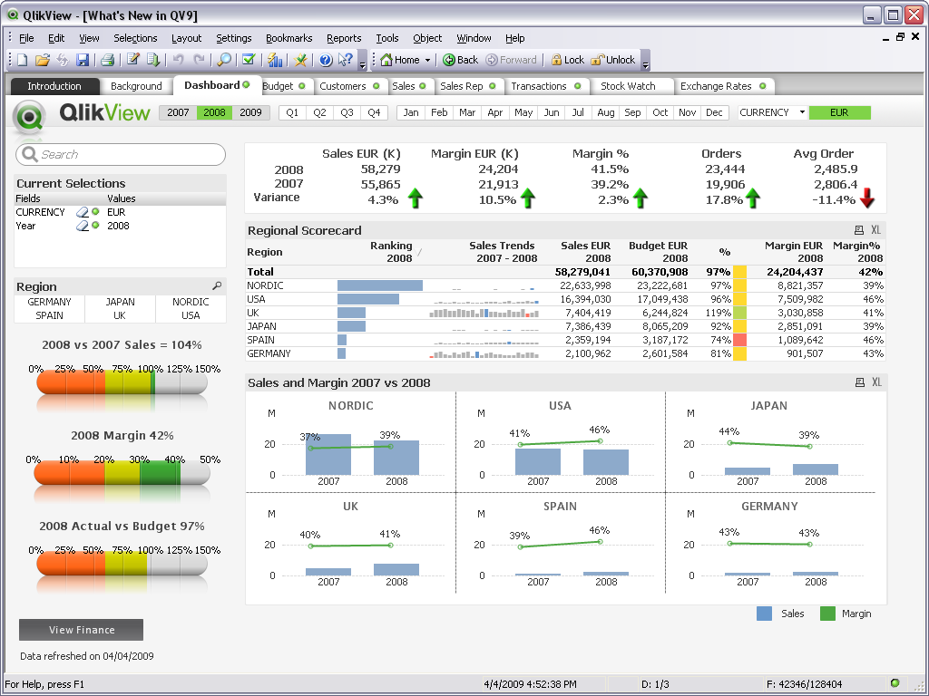
Data Visualization

Slide 36
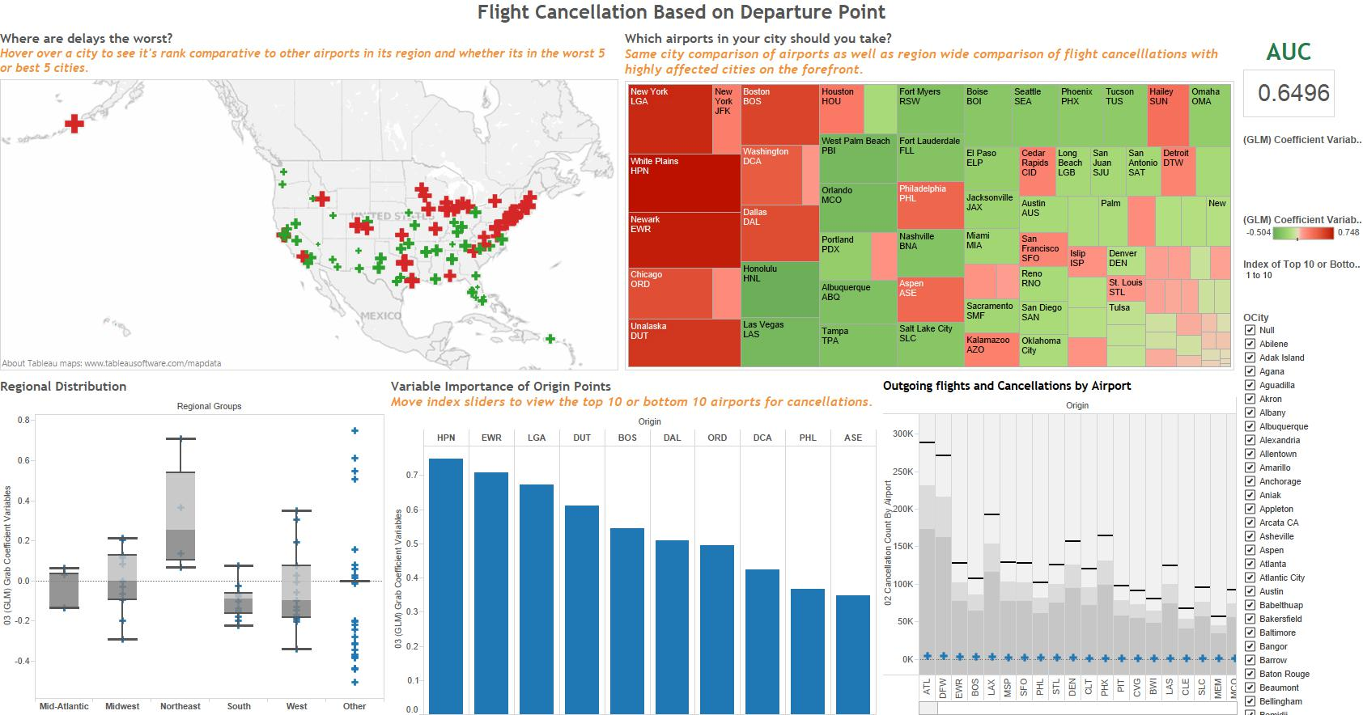
Data Visualization

Slide 37

Data Visualization

Slide 38
Resources: Datasets
UCI Repository: http://www.ics.uci.edu/~mlearn/MLRepository.html
UCI KDD Archive: http://kdd.ics.uci.edu/summary.data.application.html
Statlib: http://lib.stat.cmu.edu/
Delve: http://www.cs.utoronto.ca/~delve/

Slide 39
#This will launch R interpreter and you will get a prompt > where you can start typing your program as follows −
myString <- "Hello, World!"
myString <- "Hello, World!" print ( myString)
# My first program in R Programming myString
<- "Hello, World!"
print ( myString)
# My first program in R Programming
if(FALSE) { "This is a demo for multi-line comments and it should be put inside either a single OR double quote" } myString <- "Hello, World!" print ( myString) # Create a vector. apple <- c('red','green',"yellow") print(apple) # Get the class of the vector. print(class(apple)) # Create a list. list1 <- list(c(2,5,3),21.3,sin) # Print the list. print(list1)

Slide 40
Communication with R
In my opinion, the R/S language has become the most common language for communication in the fields of Statistics and and Data Analysis.
Books are being written now with R presented directly placed within the text.
SV use R, for example
Excellent for teaching.

Slide 41
R Software
To download R
http://www.r-project.org/
CRAN
Manuals
The R Journal
Books

Slide 42
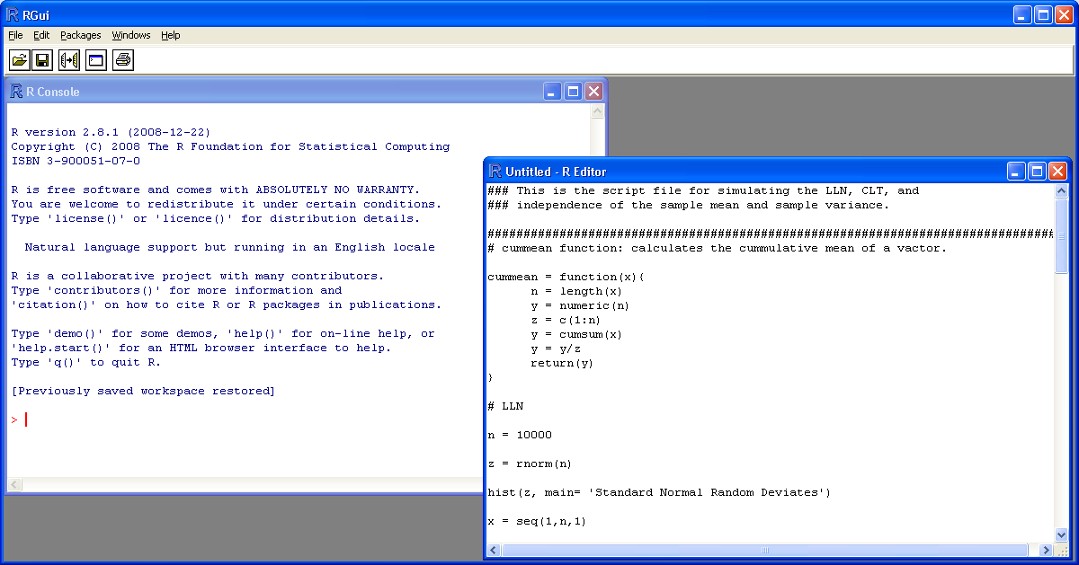
R Software

Slide 43
R Interfaces
RWinEdt
Tinn-R
JGR (Java Gui for R)
Emacs + ESS
Rattle
AKward
Playwith (for graphics)

Slide 44
R code
> 2+2
[1] 4
> 2+2^2
[1] 6
> (2+2)^2
[1] 16
> sqrt(2)
[1] 1.414214
> log(2)
[1] 0.6931472
> x = 5
> y = 10
> z <- x+y
> z
[1] 15

Slide 45
How To Set Up R on Ubuntu
R packages for Ubuntu on i386 and amd64 are available for all stable Desktop releases of Ubuntu until their official end of life date. However, only the latest Long Term Support (LTS) release is fully supported. As of May 3, 2017 the supported releases are Zesty Zapus (17.04), Yakkety Yak (16.10), Xenial Xerus (16.04; LTS), and Trusty Tahr (14.04; LTS). R 3.3.0 and above is not supported for Precise Pangolin (12.04; LTS), but previous builds will remain here until end of life for 12.04.
See https://wiki.ubuntu.com/Releases for details.
# Installation
To obtain the latest R packages, add an entry like
deb https://<my.favorite.cran.mirror>/bin/linux/ubuntu zesty/
or
deb https://<my.favorite.cran.mirror>/bin/linux/ubuntu yakkety/
or
deb https://<my.favorite.cran.mirror>/bin/linux/ubuntu xenial/
or
deb https://<my.favorite.cran.mirror>/bin/linux/ubuntu trusty/
or
deb https://<my.favorite.cran.mirror>/bin/linux/ubuntu precise/
or
in your /etc/apt/sources.list file, replacing <my.favorite.cran.mirror> by the actual URL of your favorite CRAN mirror. See https://cran.r-project.org/mirrors.html for the list of CRAN mirrors. To install the complete R system, use

Slide 46
sudo apt-get update
sudo apt-get install r-base
Users who need to compile R packages from source [e.g. package maintainers, or anyone installing packages with install.packages()] should also install the r-base-dev package:
sudo apt-get install r-base-dev
The R packages for Ubuntu otherwise behave like the Debian ones. One may find additional information in the Debian README file located at https://cran.R-project.org/bin/linux/debian/.
Installation and compilation of R or some of its packages may require Ubuntu packages from the "backports" repositories. Therefore, it is suggested to activate the backports repositories with an entry like
deb https://<my.favorite.ubuntu.mirror>/ trusty-backports main restricted universe
in your /etc/apt/sources.list file. See https://launchpad.net/ubuntu/+archivemirrors for the list of Ubuntu mirrors.
# Supported Packages

Slide 47
sudo apt-get build-dep r-cran-foo
# Secure APT
The Ubuntu archives on CRAN are signed with the key of "Michael Rutter <marutter@gmail.com>" with key ID E084DAB9. To add the key to your system with one command use (thanks to Brett Presnell for the tip):
sudo apt-key adv --keyserver keyserver.ubuntu.com --recv-keys E084DAB9
An alternate method can be used by retrieving the key with
gpg --keyserver keyserver.ubuntu.com --recv-key E084DAB9
and then feed it to apt-key with
gpg -a --export E084DAB9 | sudo apt-key add -
Some people have reported difficulties using this approach. The issue is usually related to a firewall blocking port 11371. If the first gpg command fails, you may want to try (thanks to Mischan Toosarani for the tip):
gpg --keyserver hkp://keyserver.ubuntu.com:80 --recv-keys E084DAB9
and then feed it to apt-key with
gpg -a --export E084DAB9 | sudo apt-key add -
Another alternative approach is to search for the key at http://keyserver.ubuntu.com:11371/ and copy the key to a plain text file, say key.txt. Then, feed the key to apt-key with
sudo apt-key add key.txt

Slide 48
# Administration and Maintances of R Packages
The R packages part of the Ubuntu r-base and r-recommended packages are installed into the directory /usr/lib/R/library. These can be updated using apt-get with
sudo apt-get update
sudo apt-get upgrade
The other r-cran-* packages shipped with Ubuntu are installed into the directory /usr/lib/R/site-library.
Installing R packages not provided with Ubuntu first requires tools to compile the packages from source. These tools are installed via the R development package with
sudo apt-get install r-base-dev
Then a site administrator can install R packages into the directory /usr/local/lib/R/site-library by running R as root and using the
> install.packages()

Slide 49
R Command Prompt
Once you have R environment setup, then it’s easy to start your R command prompt by just typing the following command at your command prompt −
$ R
This will launch R interpreter and you will get a prompt > where you can start typing your program as follows −
> myString <- "Hello, World!"
> print ( myString)
[1] "Hello, World!"
Here first statement defines a string variable myString, where we assign a string "Hello, World!" and then next statement print() is being used to print the value stored in variable myString.

Slide 50
R Script File
Usually, you will do your programming by writing your programs in script files and then you execute those scripts at your command prompt with the help of R interpreter called Rscript. So let's start with writing following code in a text file called test.R as under −
# My first program in R Programming
myString <- "Hello, World!"
print ( myString)
Save the above code in a file test.R and execute it at Linux command prompt as given below. Even if you are using Windows or other system, syntax will remain same.
$ Rscript test.R
When we run the above program, it produces the following result.
[1] "Hello, World!"

Slide 51
Comments
Comments are like helping text in your R program and they are ignored by the interpreter while executing your actual program. Single comment is written using # in the beginning of the statement as follows −
# My first program in R Programming
R does not support multi-line comments but you can perform a trick which is something as follows −
if(FALSE) {
"This is a demo for multi-line comments and it should be put inside either a single
OR double quote"
}
myString <- "Hello, World!"

Slide 52
Data Type | Example | Verify
Logical | TRUE, FALSE | v <- TRUE print(class(v)) it produces the following result − [1] "logical"
Numeric | 12.3, 5, 999 | v <- 23.5print(class(v)) it produces the following result − [1] "numeric"
Integer | 2L, 34L, 0L | v <- 2Lprint(class(v)) it produces the following result − [1] "integer"
Complex | 3 + 2i | v <- 2+5iprint(class(v)) it produces the following result − [1] "complex"
Character | 'a' , '"good", "TRUE", '23.4' | v <- "TRUE"print(class(v)) it produces the following result − [1] "character"
Raw | "Hello" is stored as 48 65 6c 6c 6f | v <- charToRaw("Hello")print(class(v)) it produces the following result − [1] "raw"

Slide 53
Vectors
When you want to create vector with more than one element, you should use c() function which means to combine the elements into a vector.
# Create a vector.
apple <- c('red','green',"yellow")print(apple)
# Get the class of the vector.print(class(apple))
When we execute the above code, it produces the following result −
[1] "red" "green" "yellow"[1] "character"

Slide 54
Using the c() function
The non-character values are coerced to character type if one of the elements is a character.
# The logical and numeric values are converted to characters.
s <- c('apple','red',5,TRUE)
print(s)
When we execute the above code, it produces the following result −
[1] "apple" "red" "5" "TRUE"

Slide 55
Multiple Elements Vector
Using colon operator with numeric data
# Creating a sequence from 5 to 13.v <- 5:13print(v) # Multiple Elements Vector
Using colon operator with numeric data
# Creating a sequence from 5 to 13.
v <- 5:13
print(v)
# Creating a sequence from 6.6 to 12.6.
v <- 6.6:12.6
print(v)
# If the final element specified does not belong to the sequence then it is discarded.
v <- 3.8:11.4
print(v)
When we execute the above code, it produces the following result −
[1] 5 6 7 8 9 10 11 12 13
[1] 6.6 7.6 8.6 9.6 10.6 11.6 12.6
[1] 3.8 4.8 5.8 6.8 7.8 8.8 9.8 10.8
Creating a sequence from 6.6 to 12.6.v <- 6.6:12.6print(v) # If the final element specified does not belong to the sequence then it is discarded.v <- 3.8:11.4print(v)
When we execute the above code, it produces the following result −
[1] 5 6 7 8 9 10 11 12 13[1] 6.6 7.6 8.6 9.6 10.6 11.6 12.6[1] 3.8 4.8 5.8 6.8 7.8 8.8 9.8 10.8

Slide 56
Accessing Vector Elements
Elements of a Vector are accessed using indexing. The [ ] brackets are used for indexing. Indexing starts with position 1. Giving a negative value in the index drops that element from result.TRUE, FALSE or 0 and 1 can also be used for indexing.
# Accessing vector elements using position.
t <- c("Sun","Mon","Tue","Wed","Thurs","Fri","Sat")
u <- t[c(2,3,6)]
print(u)
# Accessing vector elements using logical indexing.
v <- t[c(TRUE,FALSE,FALSE,FALSE,FALSE,TRUE,FALSE)]
print(v)
# Accessing vector elements using negative indexing.
x <- t[c(-2,-5)]
print(x)
# Accessing vector elements using 0/1 indexing.
y <- t[c(0,0,0,0,0,0,1)]
print(y)
When we execute the above code, it produces the following result −
[1] "Mon" "Tue" "Fri"
[1] "Sun" "Fri"
[1] "Sun" "Tue" "Wed" "Fri" "Sat"
[1] "Sun"

Slide 57
Vector Manipulation
Vector Manipulation
Vector arithmetic
Two vectors of same length can be added, subtracted, multiplied or divided giving the result as a vector output.
# Create two vectors.
v1 <- c(3,8,4,5,0,11)
v2 <- c(4,11,0,8,1,2)
# Vector addition.
add.result <- v1+v2
print(add.result)
# Vector substraction.
sub.result <- v1-v2
print(sub.result)
# Vector multiplication.
multi.result <- v1*v2
print(multi.result)
# Vector division.
divi.result <- v1/v2
print(divi.result)
When we execute the above code, it produces the following result −
[1] 7 19 4 13 1 13
[1] -1 -3 4 -3 -1 9
[1] 12 88 0 40 0 22
[1] 0.7500000 0.7272727 Inf 0.6250000 0.0000000 5.5000000

Slide 58
Vector element recycling
If we apply arithmetic operations to two vectors of unequal length, then the elements of the shorter vector are recycled to complete the operations.
v1 <- c(3,8,4,5,0,11)
v2 <- c(4,11)
# V2 becomes c(4,11,4,11,4,11)
add.result <- v1+v2
print(add.result)
sub.result <- v1-v2
print(sub.result)
When we execute the above code, it produces the following result −
[1] 7 19 8 16 4 22
[1] -1 -3 0 -6 -4 0

Slide 59
Vector Element Sorting
Elements in a vector can be sorted using the sort() function.
v <- c(3,8,4,5,0,11, -9, 304)
# Sort the elements of the vector.
sort.result <- sort(v)
print(sort.result)
# Sort the elements in the reverse order.
revsort.result <- sort(v, decreasing = TRUE)
print(revsort.result)
# Sorting character vectors.
v <- c("Red","Blue","yellow","violet")
sort.result <- sort(v)
print(sort.result)
# Sorting character vectors in reverse order.
revsort.result <- sort(v, decreasing = TRUE)
print(revsort.result)
When we execute the above code, it produces the following result −
[1] -9 0 3 4 5 8 11 304
[1] 304 11 8 5 4 3 0 -9
[1] "Blue" "Red" "violet" "yellow"
[1] "yellow" "violet" "Red" "Blue"

Slide 60
Lists
A list is an R-object which can contain many different types of elements inside it like vectors, functions and even another list inside it.
# Create a list.list1 <- list(c(2,5,3),21.3,sin) # Print the list.print(list1)
When we execute the above code, it produces the following result −
[[1]]
[1] 2 5 3
[[2]]
[1] 21.3
[[3]]
function (x) .Primitive("sin")

Slide 61
Matrices
A matrix is a two-dimensional rectangular data set. It can be created using a vector input to the matrix function.
# Create a matrix.M = matrix( c('a','a','b','c','b','a'), nrow = 2, ncol = 3, byrow = TRUE)print(M)
When we execute the above code, it produces the following result −
[,1] [,2] [,3]
[1,] "a" "a" "b"
[2,] "c" "b" "a"

Slide 62
Syntax
The basic syntax for creating a matrix in R is −
matrix(data, nrow, ncol, byrow, dimnames)
Following is the description of the parameters used −
• data is the input vector which becomes the data elements of the matrix.
• nrow is the number of rows to be created.
• ncol is the number of columns to be created.
• byrow is a logical clue. If TRUE then the input vector elements are arranged by row.
• dimname is the names assigned to the rows and columns.

Slide 63
Create a matrix taking a vector of numbers as input
# Elements are arranged sequentially by row.
M <- matrix(c(3:14), nrow = 4, byrow = TRUE)
print(M)
# Elements are arranged sequentially by column.
N <- matrix(c(3:14), nrow = 4, byrow = FALSE)
print(N)
# Define the column and row names.
rownames = c("row1", "row2", "row3", "row4")
colnames = c("col1", "col2", "col3")
P <- matrix(c(3:14), nrow = 4, byrow = TRUE, dimnames = list(rownames, colnames))
print(P)
When we execute the above code, it produces the following result −
[,1] [,2] [,3]
[1,] 3 4 5
[2,] 6 7 8
[3,] 9 10 11
[4,] 12 13 14
[,1] [,2] [,3]
[1,] 3 7 11
[2,] 4 8 12
[3,] 5 9 13
[4,] 6 10 14

Slide 64
Accessing Elements of a Matrix
Elements of a matrix can be accessed by using the column and row index of the element. We consider the matrix P above to find the specific elements below.
# Define the column and row names.
rownames = c("row1", "row2", "row3", "row4")
colnames = c("col1", "col2", "col3")
# Create the matrix.
P <- matrix(c(3:14), nrow = 4, byrow = TRUE, dimnames = list(rownames, colnames))
# Access the element at 3rd column and 1st row.
print(P[1,3])
# Access the element at 2nd column and 4th row.
print(P[4,2])
# Access only the 2nd row.
print(P[2,])
# Access only the 3rd column.
print(P[,3])
When we execute the above code, it produces the following result −
[1] 5
[1] 13
col1 col2 col3
6 7 8
row1 row2 row3 row4
5 8 11 14

Slide 65
Matrix Computations
Various mathematical operations are performed on the matrices using the R operators. The result of the operation is also a matrix.
The dimensions (number of rows and columns) should be same for the matrices involved in the operation.
Matrix Addition & Subtraction
# Create two 2x3 matrices.
matrix1 <- matrix(c(3, 9, -1, 4, 2, 6), nrow = 2)
print(matrix1)
matrix2 <- matrix(c(5, 2, 0, 9, 3, 4), nrow = 2)
print(matrix2)
# Add the matrices.
result <- matrix1 + matrix2
cat("Result of addition","\n")
print(result)
# Subtract the matrices
result <- matrix1 - matrix2
cat("Result of subtraction","\n")
print(result)
When we execute the above code, it produces the following result −
[,1] [,2] [,3]
[1,] 3 -1 2
[2,] 9 4 6
[,1] [,2] [,3]
[1,] 5 0 3
[2,] 2 9 4
Result of addition
[,1] [,2] [,3]
[1,] 8 -1 5
[2,] 11 13 10
Result of subtraction
[,1] [,2] [,3]
[1,] -2 -1 -1
[2,] 7 -5 2

Slide 66
Matrix Multiplication & Division
# Create two 2x3 matrices.
matrix1 <- matrix(c(3, 9, -1, 4, 2, 6), nrow = 2)
print(matrix1)
matrix2 <- matrix(c(5, 2, 0, 9, 3, 4), nrow = 2)
print(matrix2)
# Multiply the matrices.
result <- matrix1 * matrix2
cat("Result of multiplication","\n")
print(result)
# Divide the matrices
result <- matrix1 / matrix2
cat("Result of division","\n")
print(result)
When we execute the above code, it produces the following result −
[,1] [,2] [,3]
[1,] 3 -1 2
[2,] 9 4 6
[,1] [,2] [,3]
[1,] 5 0 3
[2,] 2 9 4
Result of multiplication
[,1] [,2] [,3]
[1,] 15 0 6
[2,] 18 36 24
Result of division
[,1] [,2] [,3]
[1,] 0.6 -Inf 0.6666667
[2,] 4.5 0.4444444 1.5000000

Slide 67
Arrays
While matrices are confined to two dimensions, arrays can be of any number of dimensions. The array function takes a dim attribute which creates the required number of dimension. In the below example we create an array with two elements which are 3x3 matrices each.
# Create an array.
a <- array(c('green','yellow'),dim = c(3,3,2))
print(a)
When we execute the above code, it produces the following result −
, , 1
[,1] [,2] [,3]
[1,] "green" "yellow" "green"
[2,] "yellow" "green" "yellow"
[3,] "green" "yellow" "green"
, , 2
[,1] [,2] [,3]
[1,] "yellow" "green" "yellow"
[2,] "green" "yellow" "green"
[3,] "yellow" "green" "yellow"

Slide 68
Arrays are the R data objects which can store data in more than two dimensions. For example − If we create an array of dimension (2, 3, 4) then it creates 4 rectangular matrices each with 2 rows and 3 columns. Arrays can store only data type.
An array is created using the array() function. It takes vectors as input and uses the values in the dim parameter to create an array.
Example
The following example creates an array of two 3x3 matrices each with 3 rows and 3 columns.
# Create two vectors of different lengths.
vector1 <- c(5,9,3)
vector2 <- c(10,11,12,13,14,15)
# Take these vectors as input to the array.
result <- array(c(vector1,vector2),dim = c(3,3,2))
print(result)

Slide 69
Naming Columns and Rows
We can give names to the rows, columns and matrices in the array by using the dimnames parameter.
# Create two vectors of different lengths.
vector1 <- c(5,9,3)
vector2 <- c(10,11,12,13,14,15)
column.names <- c("COL1","COL2","COL3")
row.names <- c("ROW1","ROW2","ROW3")
matrix.names <- c("Matrix1","Matrix2")
# Take these vectors as input to the array.
result <- array(c(vector1,vector2),dim = c(3,3,2),dimnames = list(row.names,column.names,
matrix.names))
print(result)
When we execute the above code, it produces the following result −
, , Matrix1
COL1 COL2 COL3
ROW1 5 10 13
ROW2 9 11 14
ROW3 3 12 15
, , Matrix2
COL1 COL2 COL3
ROW1 5 10 13
ROW2 9 11 14
ROW3 3 12 15

Slide 70
Accessing Array Elements
# Create two vectors of different lengths.
vector1 <- c(5,9,3)
vector2 <- c(10,11,12,13,14,15)
column.names <- c("COL1","COL2","COL3")
row.names <- c("ROW1","ROW2","ROW3")
matrix.names <- c("Matrix1","Matrix2")
# Take these vectors as input to the array.
result <- array(c(vector1,vector2),dim = c(3,3,2),dimnames = list(row.names,
column.names, matrix.names))
# Print the third row of the second matrix of the array.
print(result[3,,2])
# Print the element in the 1st row and 3rd column of the 1st matrix.
print(result[1,3,1])
# Print the 2nd Matrix.
print(result[,,2])

Slide 71
Manipulating Array Elements
As array is made up matrices in multiple dimensions, the operations on elements of array are carried out by accessing elements of the matrices.
# Create two vectors of different lengths.
vector1 <- c(5,9,3)
vector2 <- c(10,11,12,13,14,15)
# Take these vectors as input to the array.
array1 <- array(c(vector1,vector2),dim = c(3,3,2))
# Create two vectors of different lengths.
vector3 <- c(9,1,0)
vector4 <- c(6,0,11,3,14,1,2,6,9)
array2 <- array(c(vector1,vector2),dim = c(3,3,2))
# create matrices from these arrays.
matrix1 <- array1[,,2]
matrix2 <- array2[,,2]
# Add the matrices.
result <- matrix1+matrix2
print(result)

Slide 72
Factors
Factors are the r-objects which are created using a vector. It stores the vector along with the distinct values of the elements in the vector as labels. The labels are always character irrespective of whether it is numeric or character or Boolean etc. in the input vector. They are useful in statistical modeling.
Factors are created using the factor() function.The nlevels functions gives the count of levels.
# Create a vector.
apple_colors <- c('green','green','yellow','red','red','red','green')
# Create a factor object.
factor_apple <- factor(apple_colors)
# Print the factor.
print(factor_apple)
print(nlevels(factor_apple))
When we execute the above code, it produces the following result −
[1] green green yellow red red red green
Levels: green red yellow
# applying the nlevels function we can know the number of distinct values
[1] 3

Slide 73
Data Frames
first column can be numeric while the second column can be character and third column can be logical. It is a list of vectors of equal length.
Data Frames are created using the data.frame() function.
# Create the data frame.
BMI <- data.frame(
gender = c("Male", "Male","Female"),
height = c(152, 171.5, 165),
weight = c(81,93, 78),
Age = c(42,38,26)
)
print(BMI)
When we execute the above code, it produces the following result −
gender height weight Age
1 Male 152.0 81 42
2 Male 171.5 93 38
3 Female 165.0 78 26

Slide 74
Factors in Data Frame
On creating any data frame with a column of text data, R treats the text column as categorical data and creates factors on it.
# Create the vectors for data frame.
height <- c(132,151,162,139,166,147,122)
weight <- c(48,49,66,53,67,52,40)
gender <- c("male","male","female","female","male","female","male")
# Create the data frame.
input_data <- data.frame(height,weight,gender)
print(input_data)
# Test if the gender column is a factor.
print(is.factor(input_data$gender))
# Print the gender column so see the levels.
print(input_data$gender)

Slide 75
Changing the Order of Levels
The order of the levels in a factor can be changed by applying the factor function again with new order of the levels.
data <- c("East","West","East","North","North","East","West","West","West","East","North")
# Create the factors
factor_data <- factor(data)
print(factor_data)
# Apply the factor function with required order of the level.
new_order_data <- factor(factor_data,levels = c("East","West","North"))
print(new_order_data)

Slide 76
Generating Factor Levels
We can generate factor levels by using the gl() function. It takes two integers as input which indicates how many levels and how many times each level.
Syntax
gl(n, k, labels)
Following is the description of the parameters used −
• n is a integer giving the number of levels.
• k is a integer giving the number of replications.
• labels is a vector of labels for the resulting factor levels.
Example
v <- gl(3, 4, labels = c("Tampa", "Seattle","Boston"))
print(v)
When we execute the above code, it produces the following result −
Tampa Tampa Tampa Tampa Seattle Seattle Seattle Seattle Boston
[10] Boston Boston Boston
Levels: Tampa Seattle Boston

Slide 77
Create Data Frame
# Create the data frame.
emp.data <- data.frame(
emp_id = c (1:5),
emp_name = c("Rick","Dan","Michelle","Ryan","Gary"),
salary = c(623.3,515.2,611.0,729.0,843.25),
start_date = as.Date(c("2012-01-01", "2013-09-23", "2014-11-15", "2014-05-11",
"2015-03-27")),
stringsAsFactors = FALSE
)
# Print the data frame.
print(emp.data)
When we execute the above code, it produces the following result −
emp_id emp_name salary start_date
1 1 Rick 623.30 2012-01-01
2 2 Dan 515.20 2013-09-23
3 3 Michelle 611.00 2014-11-15
4 4 Ryan 729.00 2014-05-11
5 5 Gary 843.25 2015-03-27

Slide 78
Get the Structure of the Data Frame
The structure of the data frame can be seen by using str() function.
# Create the data frame.
emp.data <- data.frame(
emp_id = c (1:5),
emp_name = c("Rick","Dan","Michelle","Ryan","Gary"),
salary = c(623.3,515.2,611.0,729.0,843.25),
start_date = as.Date(c("2012-01-01", "2013-09-23", "2014-11-15", "2014-05-11",
"2015-03-27")),
stringsAsFactors = FALSE
)
# Get the structure of the data frame.
str(emp.data)

Slide 79
Summary of Data in Data Frame
The statistical summary and nature of the data can be obtained by applying summary() function.
# Create the data frame.
emp.data <- data.frame(
emp_id = c (1:5),
emp_name = c("Rick","Dan","Michelle","Ryan","Gary"),
salary = c(623.3,515.2,611.0,729.0,843.25),
start_date = as.Date(c("2012-01-01", "2013-09-23", "2014-11-15", "2014-05-11",
"2015-03-27")),
stringsAsFactors = FALSE
)
# Print the summary.
print(summary(emp.data))

Slide 80
Extract Data from Data Frame
Extract specific column from a data frame using column name.
# Create the data frame.
emp.data <- data.frame(
emp_id = c (1:5),
emp_name = c("Rick","Dan","Michelle","Ryan","Gary"),
salary = c(623.3,515.2,611.0,729.0,843.25),
start_date = as.Date(c("2012-01-01","2013-09-23","2014-11-15","2014-05-11",
"2015-03-27")),
stringsAsFactors = FALSE
)
# Extract Specific columns.
result <- data.frame(emp.data$emp_name,emp.data$salary)
print(result)

Slide 81
Extract the first two rows and then all columns
# Create the data frame.
emp.data <- data.frame(
emp_id = c (1:5),
emp_name = c("Rick","Dan","Michelle","Ryan","Gary"),
salary = c(623.3,515.2,611.0,729.0,843.25),
start_date = as.Date(c("2012-01-01", "2013-09-23", "2014-11-15", "2014-05-11",
"2015-03-27")),
stringsAsFactors = FALSE
)
# Extract first two rows.
result <- emp.data[1:2,]
print(result)

Slide 82
Expand Data Frame
A data frame can be expanded by adding columns and rows.
Add Column
Just add the column vector using a new column name.
# Create the data frame.
emp.data <- data.frame(
emp_id = c (1:5),
emp_name = c("Rick","Dan","Michelle","Ryan","Gary"),
salary = c(623.3,515.2,611.0,729.0,843.25),
start_date = as.Date(c("2012-01-01", "2013-09-23", "2014-11-15", "2014-05-11",
"2015-03-27")),
stringsAsFactors = FALSE
)
# Add the "dept" coulmn.
emp.data$dept <- c("IT","Operations","IT","HR","Finance")
v <- emp.data
print(v)

Slide 83
Add Row
# Create the first data frame.
emp.data <- data.frame(
emp_id = c (1:5),
emp_name = c("Rick","Dan","Michelle","Ryan","Gary"),
salary = c(623.3,515.2,611.0,729.0,843.25),
start_date = as.Date(c("2012-01-01", "2013-09-23", "2014-11-15", "2014-05-11",
"2015-03-27")),
dept = c("IT","Operations","IT","HR","Finance"),
stringsAsFactors = FALSE
)
# Create the second data frame
emp.newdata <- data.frame(
emp_id = c (6:8),
emp_name = c("Rasmi","Pranab","Tusar"),
salary = c(578.0,722.5,632.8),
start_date = as.Date(c("2013-05-21","2013-07-30","2014-06-17")),
dept = c("IT","Operations","Fianance"),
stringsAsFactors = FALSE
)
# Bind the two data frames.
emp.finaldata <- rbind(emp.data,emp.newdata)
print(emp.finaldata)

Slide 84
Variable Assignment
The variables can be assigned values using leftward, rightward and equal to operator. The values of the variables can be printed using print() or cat()function. The cat() function combines multiple items into a continuous print output.
# Assignment using equal operator.
var.1 = c(0,1,2,3)
# Assignment using leftward operator.
var.2 <- c("learn","R")
# Assignment using rightward operator.
c(TRUE,1) -> var.3
print(var.1)
cat ("var.1 is ", var.1 ,"\n")
cat ("var.2 is ", var.2 ,"\n")
cat ("var.3 is ", var.3 ,"\n")
When we execute the above code, it produces the following result −
[1] 0 1 2 3
var.1 is 0 1 2 3
var.2 is learn R
var.3 is 1 1

Slide 85
Data Type of a Variable
In R, a variable itself is not declared of any data type, rather it gets the data type of the R - object assigned to it. So R is called a dynamically typed language, which means that we can change a variable’s data type of the same variable again and again when using it in a program.
var_x <- "Hello"
cat("The class of var_x is ",class(var_x),"\n")
var_x <- 34.5
cat(" Now the class of var_x is ",class(var_x),"\n")
var_x <- 27L
cat(" Next the class of var_x becomes ",class(var_x),"\n")
When we execute the above code, it produces the following result −
The class of var_x is character
Now the class of var_x is numeric
Next the class of var_x becomes integer

Slide 86
Finding Variables
To know all the variables currently available in the workspace we use the ls() function. Also the ls() function can use patterns to match the variable names.
print(ls())
When we execute the above code, it produces the following result −
[1] "my var" "my_new_var" "my_var" "var.1"
[5] "var.2" "var.3" "var.name" "var_name2."
[9] "var_x" "varname"
Note − It is a sample output depending on what variables are declared in your environment.
The ls() function can use patterns to match the variable names.
# List the variables starting with the pattern "var".
print(ls(pattern = "var"))
When we execute the above code, it produces the following result −
[1] "my var" "my_new_var" "my_var" "var.1"
[5] "var.2" "var.3" "var.name" "var_name2."
[9] "var_x" "varname"

Slide 87
The variables starting with dot(.) are hidden, they can be listed using "all.names = TRUE" argument to ls() function.
print(ls(all.name = TRUE))
When we execute the above code, it produces the following result −
[1] ".cars" ".Random.seed" ".var_name" ".varname" ".varname2"
[6] "my var" "my_new_var" "my_var" "var.1" "var.2"
[11]"var.3" "var.name" "var_name2." "var_x"

Slide 88
Deleting Variables
Variables can be deleted by using the rm() function. Below we delete the variable var.3. On printing the value of the variable error is thrown.
rm(var.3)
print(var.3)
When we execute the above code, it produces the following result −
[1] "var.3"
Error in print(var.3) : object 'var.3' not found
All the variables can be deleted by using the rm() and ls() function together.
rm(list = ls())
print(ls())
When we execute the above code, it produces the following result −
character(0)

Slide 89
Operator | Description | Example
+ | Adds two vectors | v <- c( 2,5.5,6)t <- c(8, 3, 4)print(v+t) it produces the following result − [1] 10.0 8.5 10.0
− | Subtracts second vector from the first | v <- c( 2,5.5,6)t <- c(8, 3, 4)print(v-t) it produces the following result − [1] -6.0 2.5 2.0
* | Multiplies both vectors | v <- c( 2,5.5,6)t <- c(8, 3, 4)print(v*t) it produces the following result − [1] 16.0 16.5 24.0
/ | Divide the first vector with the second | v <- c( 2,5.5,6)t <- c(8, 3, 4)print(v/t) When we execute the above code, it produces the following result − [1] 0.250000 1.833333 1.500000
%% | Give the remainder of the first vector with the second | v <- c( 2,5.5,6)t <- c(8, 3, 4)print(v%%t) it produces the following result − [1] 2.0 2.5 2.0
%/% | The result of division of first vector with second (quotient) | v <- c( 2,5.5,6)t <- c(8, 3, 4)print(v%/%t) it produces the following result − [1] 0 1 1
^ | The first vector raised to the exponent of second vector | v <- c( 2,5.5,6)t <- c(8, 3, 4)print(v^t) it produces the following result − [1] 256.000 166.375 1296.000

Slide 90
Decision making structures
Sr.No. | Statement & Description
1 | if statement An if statement consists of a Boolean expression followed by one or more statements.
2 | if...else statement An if statement can be followed by an optional else statement, which executes when the Boolean expression is false.
3 | switch statement A switch statement allows a variable to be tested for equality against a list of values.

Slide 91
Built-in Function
Simple examples of in-built functions are seq(), mean(), max(), sum(x) and paste(...) etc. They are directly called by user written programs. You can refer most widely used R functions.
# Create a sequence of numbers from 32 to 44.
print(seq(32,44))
# Find mean of numbers from 25 to 82.
print(mean(25:82))
# Find sum of numbers frm 41 to 68.
print(sum(41:68))
When we execute the above code, it produces the following result −
[1] 32 33 34 35 36 37 38 39 40 41 42 43 44
[1] 53.5
[1] 1526

Slide 92
User-defined Function
We can create user-defined functions in R. They are specific to what a user wants and once created they can be used like the built-in functions. Below is an example of how a function is created and used.
# Create a function to print squares of numbers in sequence.
new.function <- function(a) {
for(i in 1:a) {
b <- i^2
print(b)
}
}
Calling a Function
# Create a function to print squares of numbers in sequence.
new.function <- function(a) {
for(i in 1:a) {
b <- i^2
print(b)
}
}
# Call the function new.function supplying 6 as an argument.
new.function(6)
When we execute the above code, it produces the following result −
[1] 1
[1] 4
[1] 9
[1] 16
[1] 25
[1] 36

Slide 93
Calling a Function without an Argument
# Create a function without an argument.
new.function <- function() {
for(i in 1:5) {
print(i^2)
}
}
# Call the function without supplying an argument.
new.function()
When we execute the above code, it produces the following result −
[1] 1
[1] 4
[1] 9
[1] 16
[1] 25

Slide 94
Calling a Function with Argument Values (by position and by name)
The arguments to a function call can be supplied in the same sequence as defined in the function or they can be supplied in a different sequence but assigned to the names of the arguments.
# Create a function with arguments.
new.function <- function(a,b,c) {
result <- a * b + c
print(result)
}
# Call the function by position of arguments.
new.function(5,3,11)
# Call the function by names of the arguments.
new.function(a = 11, b = 5, c = 3)
When we execute the above code, it produces the following result −
[1] 26
[1] 58

Slide 95
Calling a Function with Default Argument
We can define the value of the arguments in the function definition and call the function without supplying any argument to get the default result. But we can also call such functions by supplying new values of the argument and get non default result.
# Create a function with arguments.
new.function <- function(a = 3, b = 6) {
result <- a * b
print(result)
}
# Call the function without giving any argument.
new.function()
# Call the function with giving new values of the argument.
new.function(9,5)
When we execute the above code, it produces the following result −
[1] 18
[1] 45

Slide 96
R packages
R packages are a collection of R functions, complied code and sample data. They are stored under a directory called "library" in the R environment. By default, R installs a set of packages during installation. More packages are added later, when they are needed for some specific purpose. When we start the R console, only the default packages are available by default. Other packages which are already installed have to be loaded explicitly to be used by the R program that is going to use them.
All the packages available in R language are listed at R Packages.
Below is a list of commands to be used to check, verify and use the R packages.

Slide 97
Check Available R Packages
Get library locations containing R packages
.libPaths()
When we execute the above code, it produces the following result. It may vary depending on the local settings of your pc.
[2] "C:/Program Files/R/R-3.2.2/library"
Get the list of all the packages installed
library()
When we execute the above code, it produces the following result. It may vary depending on the local settings of your pc.
Packages in library ‘C:/Program Files/R/R-3.2.2/library’:
base The R Base Package
boot Bootstrap Functions (Originally by Angelo Canty
for S)
class Functions for Classification
cluster "Finding Groups in Data": Cluster Analysis
Extended Rousseeuw et al.
codetools Code Analysis Tools for R
compiler

Slide 98
Install a New Package
There are two ways to add new R packages. One is installing directly from the CRAN directory and another is downloading the package to your local system and installing it manually.
Install directly from CRAN
The following command gets the packages directly from CRAN webpage and installs the package in the R environment. You may be prompted to choose a nearest mirror. Choose the one appropriate to your location.
install.packages("Package Name")
# Install the package named "XML".
install.packages("XML")

Slide 99
Install package manually
Go to the link R Packages to download the package needed. Save the package as a .zip file in a suitable location in the local system.
Now you can run the following command to install this package in the R environment.
install.packages(file_name_with_path, repos = NULL, type = "source")
# Install the package named "XML"
install.packages("E:/XML_3.98-1.3.zip", repos = NULL, type = "source")
Load Package to Library
Before a package can be used in the code, it must be loaded to the current R environment. You also need to load a package that is already installed previously but not available in the current environment.
A package is loaded using the following command −
library("package Name", lib.loc = "path to library")
# Load the package named "XML"
install.packages("E:/XML_3.98-1.3.zip", repos = NULL, type = "source")

Slide 100
Joining Columns and Rows in a Data Frame
We can join multiple vectors to create a data frame using the cbind()function. Also we can merge two data frames using rbind() function.
# Create vector objects.
city <- c("Tampa","Seattle","Hartford","Denver")
state <- c("FL","WA","CT","CO")
zipcode <- c(33602,98104,06161,80294)
# Combine above three vectors into one data frame.
addresses <- cbind(city,state,zipcode)
# Print a header.
cat("# # # # The First data frame\n")
# Print the data frame.
print(addresses)
# Create another data frame with similar columns
new.address <- data.frame(
city = c("Lowry","Charlotte"),
state = c("CO","FL"),
zipcode = c("80230","33949"),
stringsAsFactors = FALSE
)
# Print a header.
cat("# # # The Second data frame\n")
# Print the data frame.
print(new.address)
# Combine rows form both the data frames.
all.addresses <- rbind(addresses,new.address)
# Print a header.
cat("# # # The combined data frame\n")
# Print the result.
print(all.addresses)

Slide 101
Merging Data Frames
We can merge two data frames by using the merge() function. The data frames must have same column names on which the merging happens.
In the example below, we consider the data sets about Diabetes in Pima Indian Women available in the library names "MASS". we merge the two data sets based on the values of blood pressure("bp") and body mass index("bmi"). On choosing these two columns for merging, the records where values of these two variables match in both data sets are combined together to form a single data frame.

Slide 102
Merging Data Frames
library(MASS)
merged.Pima <- merge(x = Pima.te, y = Pima.tr,
by.x = c("bp", "bmi"),
by.y = c("bp", "bmi")
)
print(merged.Pima)
nrow(merged.Pima)

Slide 103
When we execute the above code, it produces the following result −
bp bmi npreg.x glu.x skin.x ped.x age.x type.x npreg.y glu.y skin.y ped.y
1 60 33.8 1 117 23 0.466 27 No 2 125 20 0.088
2 64 29.7 2 75 24 0.370 33 No 2 100 23 0.368
3 64 31.2 5 189 33 0.583 29 Yes 3 158 13 0.295
4 64 33.2 4 117 27 0.230 24 No 1 96 27 0.289
5 66 38.1 3 115 39 0.150 28 No 1 114 36 0.289
6 68 38.5 2 100 25 0.324 26 No 7 129 49 0.439
7 70 27.4 1 116 28 0.204 21 No 0 124 20 0.254
8 70 33.1 4 91 32 0.446 22 No 9 123 44 0.374
9 70 35.4 9 124 33 0.282 34 No 6 134 23 0.542
10 72 25.6 1 157 21 0.123 24 No 4 99 17 0.294
11 72 37.7 5 95 33 0.370 27 No 6 103 32 0.324
12 74 25.9 9 134 33 0.460 81 No 8 126 38 0.162
13 74 25.9 1 95 21 0.673 36 No 8 126 38 0.162
14 78 27.6 5 88 30 0.258 37 No 6 125 31 0.565
15 78 27.6 10 122 31 0.512 45 No 6 125 31 0.565
16 78 39.4 2 112 50 0.175 24 No 4 112 40 0.236
17 88 34.5 1 117 24 0.403 40 Yes 4 127 11 0.598
age.y type.y
1 31 No
2 21 No
3 24 No
4 21 No
5 21 No
6 43 Yes
7 36 Yes
8 40 No
9 29 Yes
10 28 No
11 55 No
12 39 No
13 39 No
14 49 Yes
15 49 Yes
16 38 No
17 28 No
[1] 17

Slide 104
Melting and Casting
One of the most interesting aspects of R programming is about changing the shape of the data in multiple steps to get a desired shape. The functions used to do this are called melt() and cast().
We consider the dataset called ships present in the library called "MASS".
library(MASS)
print(ships)

Slide 105
Melt the Data
Now we melt the data to organize it, converting all columns other than type and year into multiple rows.
molten.ships <- melt(ships, id = c("type","year"))
print(molten.ships)
recasted.ship <- cast(molten.ships, type+year~variable,sum)print(recasted.ship)

Slide 106
R - CSV Files
In R, we can read data from files stored outside the R environment. We can also write data into files which will be stored and accessed by the operating system. R can read and write into various file formats like csv, excel, xml etc.
In this chapter we will learn to read data from a csv file and then write data into a csv file. The file should be present in current working directory so that R can read it. Of course we can also set our own directory and read files from there.

Slide 107
Getting and Setting the Working Directory
# Get and print current working directory.
print(getwd())
# Set current working directory.
setwd("/web/com")
# Get and print current working directory.
print(getwd())

Slide 108
Input as CSV File
id,name,salary,start_date,dept
1,Rick,623.3,2012-01-01,IT
2,Dan,515.2,2013-09-23,Operations
3,Michelle,611,2014-11-15,IT
4,Ryan,729,2014-05-11,HR
,Gary,843.25,2015-03-27,Finance
6,Nina,578,2013-05-21,IT
7,Simon,632.8,2013-07-30,Operations
8,Guru,722.5,2014-06-17,Finance

Slide 109
Reading a CSV File
Following is a simple example of read.csv() function to read a CSV file available in your current working directory −
data <- read.csv("input.csv")
print(data)

Slide 110
Analyzing the CSV File
By default the read.csv() function gives the output as a data frame. This can be easily checked as follows. Also we can check the number of columns and rows.
data <- read.csv("input.csv")
print(is.data.frame(data))
print(ncol(data))
print(nrow(data))

Slide 111
WORKSHOP1
1. Once we read data in a data frame, we can apply all the functions applicable to data frames as explained in subsequent section.
Get the maximum salary
# Create a data frame.
data <- read.csv("input.csv")
# Get the max salary from data frame.
sal <- max(data$salary)
print(sal)

Slide 112
Q2.
Get the details of the person with max salary
We can fetch rows meeting specific filter criteria similar to a SQL where clause.
# Create a data frame.
data <- read.csv("input.csv")
# Get the max salary from data frame.
sal <- max(data$salary)
# Get the person detail having max salary.
retval <- subset(data, salary == max(salary))
print(retval)

Slide 113
Q3
Get all the people working in IT department
# Create a data frame.
data <- read.csv("input.csv")
retval <- subset( data, dept == "IT")
print(retval)

Slide 114
Q4
Get the persons in IT department whose salary is greater than 600
# Create a data frame.
data <- read.csv("input.csv")
info <- subset(data, salary > 600 & dept == "IT")
print(info)

Slide 115
Q5
Get the people who joined on or after 2014
# Create a data frame.
data <- read.csv("input.csv")
retval <- subset(data, as.Date(start_date) > as.Date("2014-01-01"))
print(retval)

Slide 116
Writing into a CSV File
R can create csv file form existing data frame. The write.csv() function is used to create the csv file. This file gets created in the working directory.
# Create a data frame.
data <- read.csv("input.csv")
retval <- subset(data, as.Date(start_date) > as.Date("2014-01-01"))
# Write filtered data into a new file.
write.csv(retval,"output.csv")
newdata <- read.csv("output.csv")
print(newdata)

Slide 117
Writing into a CSV File
Here the column X comes from the data set newper. This can be dropped using additional parameters while writing the file.
# Create a data frame.
data <- read.csv("input.csv")
retval <- subset(data, as.Date(start_date) > as.Date("2014-01-01"))
# Write filtered data into a new file.
write.csv(retval,"output.csv", row.names = FALSE)
newdata <- read.csv("output.csv")
print(newdata)

Slide 118
R - Web Data
Many websites provide data for consumption by its users. For example the World Health Organization(WHO) provides reports on health and medical information in the form of CSV, txt and XML files. Using R programs, we can programmatically extract specific data from such websites. Some packages in R which are used to scrap data form the web are − "RCurl",XML", and "stringr". They are used to connect to the URL’s, identify required links for the files and download them to the local environment.

Slide 119
Install R Packages
The following packages are required for processing the URL’s and links to the files. If they are not available in your R Environment, you can install them using following commands.
install.packages("RCurl")
install.packages("XML")
install.packages("stringr")
install.packages("plyr")

Slide 120
Input Data
We will visit the URL weather data and download the CSV files using R for the year 2015.
Example
We will use the function getHTMLLinks() to gather the URLs of the files. Then we will use the function downlaod.file() to save the files to the local system. As we will be applying the same code again and again for multiple files, we will create a function to be called multiple times. The filenames are passed as parameters in form of a R list object to this function.

Slide 121
Read the URL.
# Read the URL.
url <- "http://www.geos.ed.ac.uk/~weather/jcmb_ws/"
# Gather the html links present in the webpage.
links <- getHTMLLinks(url)
# Identify only the links which point to the JCMB 2015 files.
filenames <- links[str_detect(links, "JCMB_2015")]
# Store the file names as a list.
filenames_list <- as.list(filenames)
# Create a function to download the files by passing the URL and filename list.
downloadcsv <- function (mainurl,filename) {
filedetails <- str_c(mainurl,filename)
download.file(filedetails,filename)
}
# Now apply the l_ply function and save the files into the current R working directory.
l_ply(filenames,downloadcsv,mainurl = "http://www.geos.ed.ac.uk/~weather/jcmb_ws/")

Slide 122
Verify the File Download
After running the above code, you can locate the following files in the current R working directory.
"JCMB_2015.csv" "JCMB_2015_Apr.csv" "JCMB_2015_Feb.csv" "JCMB_2015_Jan.csv"
"JCMB_2015_Mar.csv"

Slide 123
R - Databases
The data is Relational database systems are stored in a normalized format. So, to carry out statistical computing we will need very advanced and complex Sql queries. But R can connect easily to many relational databases like MySql, Oracle, Sql server etc. and fetch records from them as a data frame. Once the data is available in the R environment, it becomes a normal R data set and can be manipulated or analyzed using all the powerful packages and functions.
In this tutorial we will be using MySql as our reference database for connecting to R.

Slide 124
R MySQL Package
R has a built-in package named "RMySQL" which provides native connectivity between with MySql database. You can install this package in the R environment using the following command.
install.packages("RMySQL") R MySQL Package
R has a built-in package named "RMySQL" which provides native connectivity between with MySql database. You can install this package in the R environment using the following command.
install.packages("RMySQL")
Connecting R to MySql
Once the package is installed we create a connection object in R to connect to the database. It takes the username, password, database name and host name as input.
# Create a connection Object to MySQL database.
# We will connect to the sampel database named "sakila" that comes with MySql installation.
mysqlconnection = dbConnect(MySQL(), user = 'root', password = '', dbname = 'sakila',
host = 'localhost')
# List the tables available in this database.
dbListTables(mysqlconnection)
Connecting R to MySql
Once the package is installed we create a connection object in R to connect to the database. It takes the username, password, database name and host name as input.
# Create a connection Object to MySQL database.# We will connect to the sampel database named "sakila" that comes with MySql installation.mysqlconnection = dbConnect(MySQL(), user = 'root', password = '', dbname = 'sakila', host = 'localhost') # List the tables available in this database. dbListTables(mysqlconnection)

Slide 125
Querying the Tables
We can query the database tables in MySql using the function dbSendQuery(). The query gets executed in MySql and the result set is returned using the R fetch() function. Finally it is stored as a data frame in R.
# Query the "actor" tables to get all the rows.
result = dbSendQuery(mysqlconnection, "select * from actor")
# Store the result in a R data frame object. n = 5 is used to fetch first 5 rows.
data.frame = fetch(result, n = 5)
print(data.fame)

Slide 126
Query with Filter Clause
We can pass any valid select query to get the result.
result = dbSendQuery(mysqlconnection, "select * from actor where last_name = 'TORN'")
# Fetch all the records(with n = -1) and store it as a data frame.
data.frame = fetch(result, n = -1)
print(data)

Slide 127
Updating Rows in the Tables
We can update the rows in a Mysql table by passing the update query to the dbSendQuery() function.
dbSendQuery(mysqlconnection, "update mtcars set disp = 168.5 where hp = 110")
After executing the above code we can see the table updated in the MySql Environment.
Inserting Data into the Tables
dbSendQuery(mysqlconnection,
"insert into mtcars(row_names, mpg, cyl, disp, hp, drat, wt, qsec, vs, am, gear, carb)
values('New Mazda RX4 Wag', 21, 6, 168.5, 110, 3.9, 2.875, 17.02, 0, 1, 4, 4)"
)
After executing the above code we can see the row inserted into the table in the MySql Environment.

Slide 128
Creating Tables in MySql
We can create tables in the MySql using the function dbWriteTable(). It overwrites the table if it already exists and takes a data frame as input.
# Create the connection object to the database where we want to create the table.
mysqlconnection = dbConnect(MySQL(), user = 'root', password = '', dbname = 'sakila',
host = 'localhost')
# Use the R data frame "mtcars" to create the table in MySql.
# All the rows of mtcars are taken inot MySql.
dbWriteTable(mysqlconnection, "mtcars", mtcars[, ], overwrite = TRUE)

Slide 129
Dropping Tables in MySql
We can drop the tables in MySql database passing the drop table statement into the dbSendQuery() in the same way we used it for querying data from tables.
dbSendQuery(mysqlconnection, 'drop table if exists mtcars')
After executing the above code we can see the table is dropped in the MySql Environment.
JSON file stores data as text in human-readable format. Json stands for JavaScript Object Notation. R can read JSON files using the rjson package.

Slide 130
Install rjson Package
In the R console, you can issue the following command to install the rjson package.
install.packages("rjson")
Input Data
Create a JSON file by copying the below data into a text editor like notepad. Save the file with a .json extension and choosing the file type as all files(*.*).

Slide 131
{
"ID":["1","2","3","4","5","6","7","8" ],
"Name":["Rick","Dan","Michelle","Ryan","Gary","Nina","Simon","Guru" ],
"Salary":["623.3","515.2","611","729","843.25","578","632.8","722.5" ],
"StartDate":[ "1/1/2012","9/23/2013","11/15/2014","5/11/2014","3/27/2015","5/21/2013",
"7/30/2013","6/17/2014"],
"Dept":[ "IT","Operations","IT","HR","Finance","IT","Operations","Finance"]
}

Slide 132
Read the JSON File
The JSON file is read by R using the function from JSON(). It is stored as a list in R.
# Load the package required to read JSON files.
library("rjson")
# Give the input file name to the function.
result <- fromJSON(file = "input.json")
# Print the result.
print(result)

Slide 133
Convert JSON to a Data Frame
We can convert the extracted data above to a R data frame for further analysis using the as.data.frame() function.
# Load the package required to read JSON files.
library("rjson")
# Give the input file name to the function.
result <- fromJSON(file = "input.json")
# Convert JSON file to a data frame.
json_data_frame <- as.data.frame(result)
print(json_data_frame)

Slide 134
R - Mean, Median & Mode
Statistical analysis in R is performed by using many in-built functions. Most of these functions are part of the R base package. These functions take R vector as an input along with the arguments and give the result.
The functions we are discussing in this chapter are mean, median and mode.
Mean
It is calculated by taking the sum of the values and dividing with the number of values in a data series.
The function mean() is used to calculate this in R.
Syntax
The basic syntax for calculating mean in R is −
mean(x, trim = 0, na.rm = FALSE, ...)

Slide 135
Following is the description of the parameters used −
x is the input vector.
trim is used to drop some observations from both end of the sorted vector.
na.rm is used to remove the missing values from the input vector.
Example
# Create a vector.
x <- c(12,7,3,4.2,18,2,54,-21,8,-5)
# Find Mean.
result.mean <- mean(x)
print(result.mean)

Slide 136
applying Trim Option
When trim parameter is supplied, the values in the vector get sorted and then the required numbers of observations are dropped from calculating the mean.
When trim = 0.3, 3 values from each end will be dropped from the calculations to find mean.
In this case the sorted vector is (−21, −5, 2, 3, 4.2, 7, 8, 12, 18, 54) and the values removed from the vector for calculating mean are (−21,−5,2) from left and (12,18,54) from right.
# Create a vector.
x <- c(12,7,3,4.2,18,2,54,-21,8,-5)
# Find Mean.
result.mean <- mean(x,trim = 0.3)
print(result.mean)

Slide 137
Median
The middle most value in a data series is called the median. The median() function is used in R to calculate this value.
Syntax
The basic syntax for calculating median in R is −
median(x, na.rm = FALSE)
Following is the description of the parameters used −
x is the input vector.
na.rm is used to remove the missing values from the input vector.
Example
# Create the vector.
x <- c(12,7,3,4.2,18,2,54,-21,8,-5)
# Find the median.
median.result <- median(x)
print(median.result)

Slide 138
Mode
The mode is the value that has highest number of occurrences in a set of data. Unike mean and median, mode can have both numeric and character data.
R does not have a standard in-built function to calculate mode. So we create a user function to calculate mode of a data set in R. This function takes the vector as input and gives the mode value as output.
Example
# Create the function.
getmode <- function(v) {
uniqv <- unique(v)
uniqv[which.max(tabulate(match(v, uniqv)))]
}
# Create the vector with numbers.
v <- c(2,1,2,3,1,2,3,4,1,5,5,3,2,3)
# Calculate the mode using the user function.
result <- getmode(v)
print(result)
# Create the vector with characters.
charv <- c("o","it","the","it","it")
# Calculate the mode using the user function.
result <- getmode(charv)
print(result)

Slide 139
Linear Regression
Regression analysis is a very widely used statistical tool to establish a relationship model between two variables. One of these variable is called predictor variable whose value is gathered through experiments. The other variable is called response variable whose value is derived from the predictor variable.
In Linear Regression these two variables are related through an equation, where exponent (power) of both these variables is 1. Mathematically a linear relationship represents a straight line when plotted as a graph. A non-linear relationship where the exponent of any variable is not equal to 1 creates a curve.
The general mathematical equation for a linear regression is −
y = ax + b

Slide 140
Linear Regression
Following is the description of the parameters used −
y is the response variable.
x is the predictor variable.
a and b are constants which are called the coefficien
Input Data
Below is the sample data representing the observations −
# Values of height
151, 174, 138, 186, 128, 136, 179, 163, 152, 131
# Values of weight.
63, 81, 56, 91, 47, 57, 76, 72, 62, 48ts.

Slide 141
lm() Function
This function creates the relationship model between the predictor and the response variable.
Syntax
The basic syntax for lm() function in linear regression is −
lm(formula,data)
Following is the description of the parameters used −
formula is a symbol presenting the relation between x and y.
data is the vector on which the formula will be applied.
Create Relationship Model & get the Coefficients
x <- c(151, 174, 138, 186, 128, 136, 179, 163, 152, 131)
y <- c(63, 81, 56, 91, 47, 57, 76, 72, 62, 48)
# Apply the lm() function.
relation <- lm(y~x)
print(relation)

Slide 142
Get the Summary of the Relationship
x <- c(151, 174, 138, 186, 128, 136, 179, 163, 152, 131)
y <- c(63, 81, 56, 91, 47, 57, 76, 72, 62, 48)
# Apply the lm() function.
relation <- lm(y~x)
print(summary(relation))

Slide 143
predict() Function
The basic syntax for predict() in linear regression is −
predict(object, newdata)
Following is the description of the parameters used −
object is the formula which is already created using the lm() function.
newdata is the vector containing the new value for predictor variable.
Predict the weight of new persons
# The predictor vector.
x <- c(151, 174, 138, 186, 128, 136, 179, 163, 152, 131)
# The resposne vector.
y <- c(63, 81, 56, 91, 47, 57, 76, 72, 62, 48)
# Apply the lm() function.
relation <- lm(y~x)
# Find weight of a person with height 170.
a <- data.frame(x = 170)
result <- predict(relation,a)
print(result)

Slide 144
Visualize the Regression Graphically
# Create the predictor and response variable.
x <- c(151, 174, 138, 186, 128, 136, 179, 163, 152, 131)
y <- c(63, 81, 56, 91, 47, 57, 76, 72, 62, 48)
relation <- lm(y~x)
# Give the chart file a name.
png(file = "linearregression.png")
# Plot the chart.
plot(y,x,col = "blue",main = "Height & Weight Regression",
abline(lm(x~y)),cex = 1.3,pch = 16,xlab = "Weight in Kg",ylab = "Height in cm")
# Save the file.
dev.off()

Slide 145
Multiple Regression
Multiple regression is an extension of linear regression into relationship between more than two variables. In simple linear relation we have one predictor and one response variable, but in multiple regression we have more than one predictor variable and one response variable.
The general mathematical equation for multiple regression is −
y = a + b1x1 + b2x2 +...bnxn
Following is the description of the parameters used −
y is the response variable.
a, b1, b2...bn are the coefficients.
x1, x2, ...xn are the predictor variables.
We create the regression model using the lm() function in R. The model determines the value of the coefficients using the input data. Next we can predict the value of the response variable for a given set of predictor variables using these coefficients.

Slide 146
lm() Function
This function creates the relationship model between the predictor and the response variable.
Syntax
The basic syntax for lm() function in multiple regression is −
lm(y ~ x1+x2+x3...,data)
Following is the description of the parameters used −
formula is a symbol presenting the relation between the response variable and predictor variables.
data is the vector on which the formula will be applied.

Slide 147
Input Data
Consider the data set "mtcars" available in the R environment. It gives a comparison between different car models in terms of mileage per gallon (mpg), cylinder displacement("disp"), horse power("hp"), weight of the car("wt") and some more parameters.
The goal of the model is to establish the relationship between "mpg" as a response variable with "disp","hp" and "wt" as predictor variables. We create a subset of these variables from the mtcars data set for this purpose.
input <- mtcars[,c("mpg","disp","hp","wt")]
print(head(input))

Slide 148
Create Relationship Model & get the Coefficients
input <- mtcars[,c("mpg","disp","hp","wt")]
# Create the relationship model.
model <- lm(mpg~disp+hp+wt, data = input)
# Show the model.
print(model)
# Get the Intercept and coefficients as vector elements.
cat("# # # # The Coefficient Values # # # ","\n")
a <- coef(model)[1]
print(a)
Xdisp <- coef(model)[2]
Xhp <- coef(model)[3]
Xwt <- coef(model)[4]
print(Xdisp)
print(Xhp)
print(Xwt)

Slide 149
Chi Square Test
Chi-Square test is a statistical method to determine if two categorical variables have a significant correlation between them. Both those variables should be from same population and they should be categorical like − Yes/No, Male/Female, Red/Green etc.
For example, we can build a data set with observations on people's ice-cream buying pattern and try to correlate the gender of a person with the flavor of the ice-cream they prefer. If a correlation is found we can plan for appropriate stock of flavors by knowing the number of gender of people visiting.
Syntax
The function used for performing chi-Square test is chisq.test().
The basic syntax for creating a chi-square test in R is −
chisq.test(data)

Slide 150
Chi Square Test
Following is the description of the parameters used −
data is the data in form of a table containing the count value of the variables in the observation.
Example
We will take the Cars93 data in the "MASS" library which represents the sales of different models of car in the year 1993.
library("MASS")
print(str(Cars93))

Slide 151
# Load the library.
# Load the library.
library("MASS")
# Create a data frame from the main data set.
car.data <- data.frame(Cars93$AirBags, Cars93$Type)
# Create a table with the needed variables.
car.data = table(Cars93$AirBags, Cars93$Type)
print(car.data)
# Perform the Chi-Square test.
print(chisq.test(car.data))

Slide 152
Pie Charts
R Programming language has numerous libraries to create charts and graphs. A pie-chart is a representation of values as slices of a circle with different colors. The slices are labeled and the numbers corresponding to each slice is also represented in the chart.
In R the pie chart is created using the pie() function which takes positive numbers as a vector input. The additional parameters are used to control labels, color, title etc.
Syntax
The basic syntax for creating a pie-chart using the R is −
pie(x, labels, radius, main, col, clockwise)

Slide 153
Following is the description of the parameters used −
x is a vector containing the numeric values used in the pie chart.
labels is used to give description to the slices.
radius indicates the radius of the circle of the pie chart.(value between −1 and +1).
main indicates the title of the chart.
col indicates the color palette.
clockwise is a logical value indicating if the slices are drawn clockwise or anti clockwise.
Example
A very simple pie-chart is created using just the input vector and labels. The below script will create and save the pie chart in the current R working directory.

Slide 154
# Create data for the graph.
# Create data for the graph.
x <- c(21, 62, 10, 53)
labels <- c("London", "New York", "Singapore", "Mumbai")
# Give the chart file a name.
png(file = "city.jpg")
# Plot the chart.
pie(x,labels)
# Save the file.
dev.off()

Slide 155
Pie Chart Title and Colors
Example
The below script will create and save the pie chart in the current R working directory.
# Create data for the graph.
x <- c(21, 62, 10, 53)
labels <- c("London", "New York", "Singapore", "Mumbai")
# Give the chart file a name.
png(file = "city_title_colours.jpg")
# Plot the chart with title and rainbow color pallet.
pie(x, labels, main = "City pie chart", col = rainbow(length(x)))
# Save the file.
dev.off()

Slide 156
3D Pie Chart
# Get the library.
library(plotrix)
# Create data for the graph.
x <- c(21, 62, 10,53)
lbl <- c("London","New York","Singapore","Mumbai")
# Give the chart file a name.
png(file = "3d_pie_chart.jpg")
# Plot the chart.
pie3D(x,labels = lbl,explode = 0.1, main = "Pie Chart of Countries ")
# Save the file.
dev.off()

Slide 157
Graphics with ggplot2
In R, type install.packages("ggplot2") to install the ggplot2 package.
plot()
The qplot() function can be used to create the most common graph types. While it does not expose ggplot's full power, it can create a very wide range of useful plots. The format is:
qplot(x, y, data=, color=, shape=, size=, alpha=, geom=, method=, formula=, facets=, xlim=, ylim= xlab=, ylab=, main=, sub=)

Slide 158
Everyone: Download workshop materials:
Download materials from http://tutorials.iq.harvard.edu/R/Rgraphics.zip
Extract the zip file containing the materials to your desktop Workshop notes are available in .hmtl format. Open a file browser, navigate to your desktop and open Rgraphics.html

Slide 159
plot vs qplot
Here's how the default scatterplots look in ggplot compared to the base graphics. We'll illustrate things using the Cars93 data from the MASS library.
with(Cars93, plot(EngineSize, MPG.city)) # Base graphics qplot(x=EngineSize, y=MPG.city, data=Cars93) # using qplot from ggplot2
Remember how it took us some effort last time to add color coding, use different plotting characters, and add a legend? Here's the qplot call that does it all in one simple line.
qplot(x=EngineSize, y=MPG.city, data=Cars93, colour=Cylinders, shape=Cylinders, xlab = "Engine size (litres)", ylab = "Fuel economy (MPG city)" )
This way you won't run into problems of accidentally producing the wrong legend. The legend is produced based on thecolour and shape argument that you pass in. (Note: color and colour have the same effect. )

Slide 160
Graphics with ggplot2
Plotting the Cars93 data
ggplot function
The ggplot2 library comes with a dataset called diamonds. Let's look at it
dim(diamonds)
head(diamonds)
library(maps)
head(USArrests)
diamond.plot <- ggplot(data=diamonds, aes(x=carat, y=price))
diamond.plot + geom_point()
diamond.plot + geom_point(size = 0.7, alpha = 0.3)
If we wanted to let point color depend on the color indicator of the diamond, we could do so in the following way.
diamond.plot <- ggplot(data=diamonds, aes(x=carat, y=price, colour = color))
diamond.plot + geom_point()
es the Cars93 dataset from the MASS package.
(a) Use qplot to create a scatterplot with Price on the y-axis and EngineSize on the x-axis.
qplot(x = EngineSize, y = Price, data = Cars93)
(b) Repeat part (a) using the ggplot function and geom_point() layer.
ggplot(Cars93, aes(x = EngineSize, y = Price)) + geom_point()
(c) Repeat part (b), but this time specifying that the color mapping should depend on Type and the shape mapping should depend on DriveTrain.
ggplot(Cars93, aes(x = EngineSize, y = Price, colour = Type, shape = DriveTrain)) + geom_point()

Slide 161
Graphics with ggplot2
Here's how we can get a headmap of Murder rates (per 100,000 population) on a map of the US.
# Create data frame for map data (US states)
states <- map_data("state")
# Here's what the states data frame looks like str(states)
# Make a copy of the data frame to manipulate
arrests <- USArrests
Convert everything to lower case
names(arrests) <- tolower(names(arrests)) arrests$region <- tolower(rownames(USArrests))
# Merge the map data with the arrests data based on region
choro <- merge(states, arrests, sort = FALSE, by = "region")
choro <- choro[order(choro$order), ]
# Plot a map, filling in the states based on murder rate
qplot(long, lat, data = choro, group = group, fill = murder, geom = "polygon")

Slide 162
WorkShop2
(a) Construct histograms of MPG.highway, one plot for each Origin category.
(b) Using the Cars93 data and the t.test() function, run a t-test to see if average MPG.highway is different between US and non-US vehicles.

Slide 163
Workshop3
ANOVA with birthwt data
(a) Create a new factor that categorizes the number of physician visits into three levels: 0, 1, 2, 3 or more.
(b) Run an ANOVA to determine whether the average birth weight varies across number of physician visits.
The p-value is greater than 0.05, so the variation in birthweight across number of physician visits is not statistically significant.

Slide 164
References
https://www.tutorialspoint.com/r/index.htm
https://www.r-bloggers.com/
https://www.rstudio.com/
https://cran.rstudio.com/

